Slide 1

Comité de Acción de Resistencia a Herbicidas
Rafael Frene. May, 2017

Slide 2








Coordinating Institution
Affiliated Institution

Slide 3

Objectives
Training and education:
Generate information and promote the education of Growers and advisers on the implementation of Good Agricultural Practices and Responsible Use of Agrochemical Products, focusing on weed & herbicides management.
Institutional:
Public-private inter-institutional relationship.
(REM / AAPRESID; CREA; INTA; Universities; SENASA; CONABIA)
Research activities:
Sponsor of studies and development of strategies for weed management and prevention of herbicide resistance.

Slide 4
Mission
Promote the responsible use of herbicides.
Support and participate in research programs, conferences and seminars to help to increase knowledge and awareness of herbicides and weed management.
Promote a better understanding about causes and consequences of herbicide resistance.
Communicate herbicide resistance management strategies and support their implementation through technical recommendations.
Seek active collaboration with public and private researchers, focusing on problem identification areas, devising and implementing management strategies.
Enhance communication between industry representatives, growers, technical advisors and researchers.

Slide 5
Network:
Official Regulatory Authorities:
SENASA: Feed & Food department.
CONABIA: National Commission on Agricultural Biotechnology.
Private organizations:
AAPRESID / REM: No-till grower association. Resistant weeds know-how net through REM coordinated by AAPRESID.
CREA: High tech grower org. Currently an internal group with focus on weeds issue.
CASAFE: Agrochemical and Fertilizer companies.
ASA: Seed Companies Association.
ASACIM: National Association of Weed Science.
Official Institutions:
INTA: National Institute of Ag. Technology.
Universities: UBA (Universidad de Buenos Aires); UNR (Universidad Nacional de Rosario) EEAOC (Estación Experimental Agropecuaria Obispo Colombres)

Slide 6
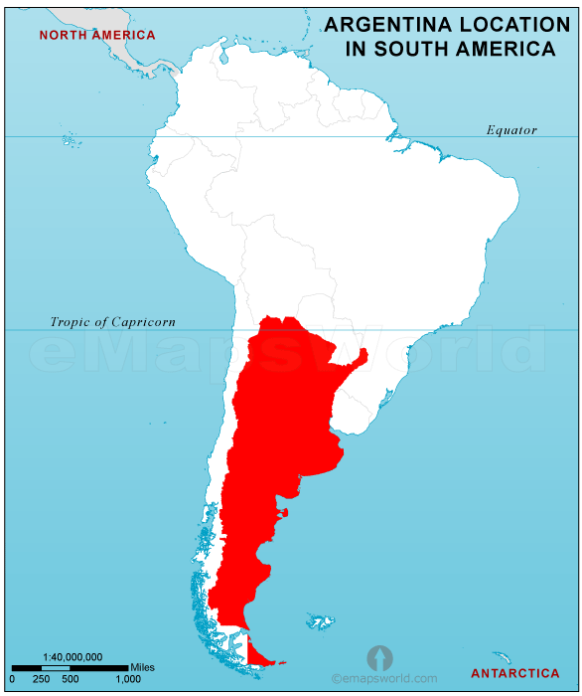
Introduction: Argentina Crop production.
Planted area by crop: (2016)
Soybean: 20.0 MM ha
Corn: 5.0 MM ha
Wheat: 4.0 MM ha
Sunflower: 2.0 MM ha
Barley: 0.6 MM ha
Cotton: 0.4 MM ha
Others: 1.5 MM ha
High adoption of no-till crop production >80%.
Market size: (MM u$s)
Argentina 3.6 B
Crop Protection: 2.5 B
Seeds: 1.1 B

Slide 7
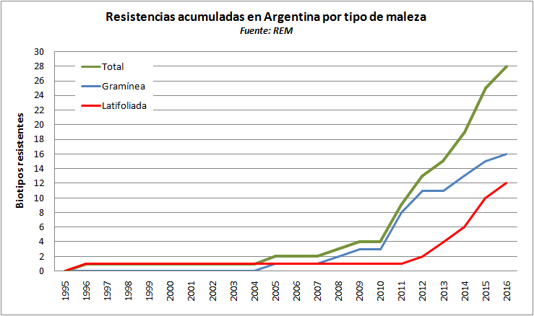

Weeds Issue: current situation and trends:
< selectivity
Current < control levels
Scenario > work & time
+++ U$S
Network of knowledge of resistant weeds
28 biotypes / 18 species / 16 Gly-res / 4 different MOA / 5 multiple-res
several Gly-Tolerant species covering relevant areas
Key market drivers:
Generic growing and high technical complexity
Exponential growth of gly-res Amaranthus spp. and grasses
Conyza keeps the area, but does not forgive errors in weed management
No weed control programs adoption so far…

Slide 8

Argentina: Herbicide Market and Trends
ARG: Herbicides Market (%) | 2010 | 2012 | 2014 | 2016
GLYPHOSATE | 70 | 61 | 53 | 43
NO GLYPHOSATE HERB | 30 | 39 | 47 | 57
Source:

Slide 9
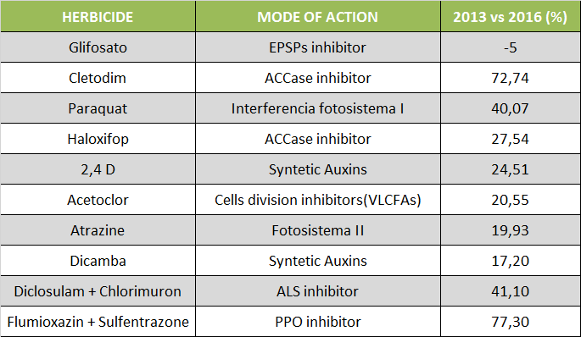
Variation in the Herbicides Market:
(in % of quantity) - 2014 vs 2016
Source: by Pampas Group for CASAFE. Argentina.

Slide 10
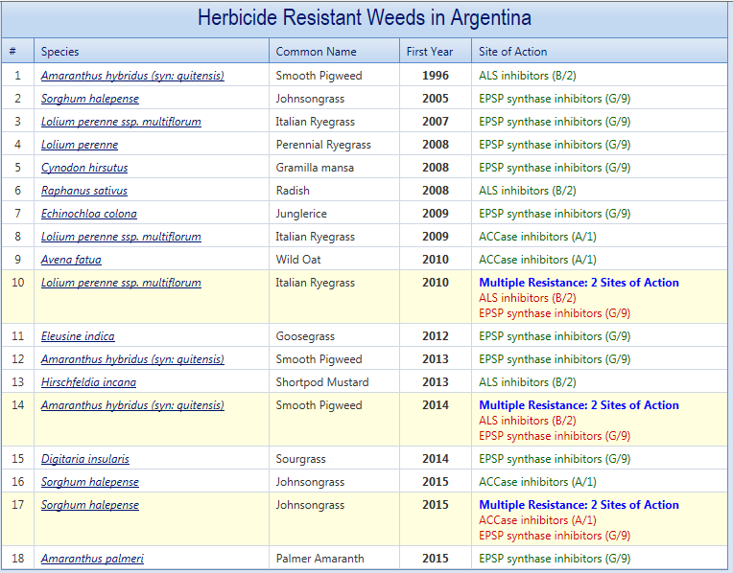
Argentina Current situation:
Heap, I. The International Survey of Herbicide Resistant Weeds. Online. Internet. Sunday, May 7, 2017 . Available www.weedscience.org

Slide 11
Activities on going…
Relationship with REM & CREA:
- Seminars and technical trainings of Herbicide MOA and Weed Management. (audience: growers, advisers)
- Developing a Herbicide MOA Document (including the most used MOA and rotation recommendations)
- Developing a Biotechnology document regarding the herbicide traits used and nearby, including Stewardship and sustainability plans for future technologies
- HRAC participation in the XXV No-Till National Congress, Aug2017.
Official Authorities (SENASA & CONABIA):
- Meetings & field tours to promote the representativeness of HRAC with the official organizations.

Slide 12
What do we need from GHRAC ?
- Build a strong relationship with GHRAC. Offer direct access to the GHRAC site via a link from HRAC Arg web page.
- As HRAC Argentina, be able to offer to the technical community access to reliable and useful weed / herbicides information from other agricultural world regions.
- Support from GHRAC to contact researchers / Universities to local seminaries and congress organized either by HRAC Arg or other local organizations (AAPRESID / CREA).
- In Argentina it is imperative that public opinion perceive that the weed issue is an important concern for the industry and that it seeks sustainable and environmentally conscious solutions.

Slide 13
Contact
www.hrac-argentina.org

