Slide 1

Herbicide Resistance Action Committee Asia
Luis Camacho and Vinod Shivrain
May 2017

Slide 2
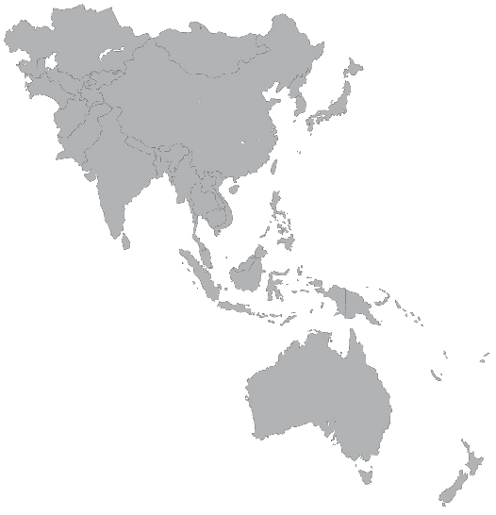
Asia Pacific – China region at a glance
Asia Pacific accounted for approximately 25% share of the global herbicides market.
China is a major consumer of herbicides in Asia Pacific and is the fastest-growing country.
Large number of very small customers operating with a high degree of relative risk – applying incorrect doses, incorrect application timings and using illegal/counterfeit products in which the dose/efficacy is unknown.
Confirmed cases of herbicide resistance reported.
Absence of MoA labeling classification.
There are some countries banning certain herbicides products.
Challenging capacity building.
Herbicide tolerant traits introduced in the Philippines and Vietnam and approved in Pakistan.
Escalated use and demand for generic products
China
Korea
Pakistan
India
Taiwan
Vietnam
Thailand
Philippines
Malaysia
Singapore
Indonesia

Slide 3
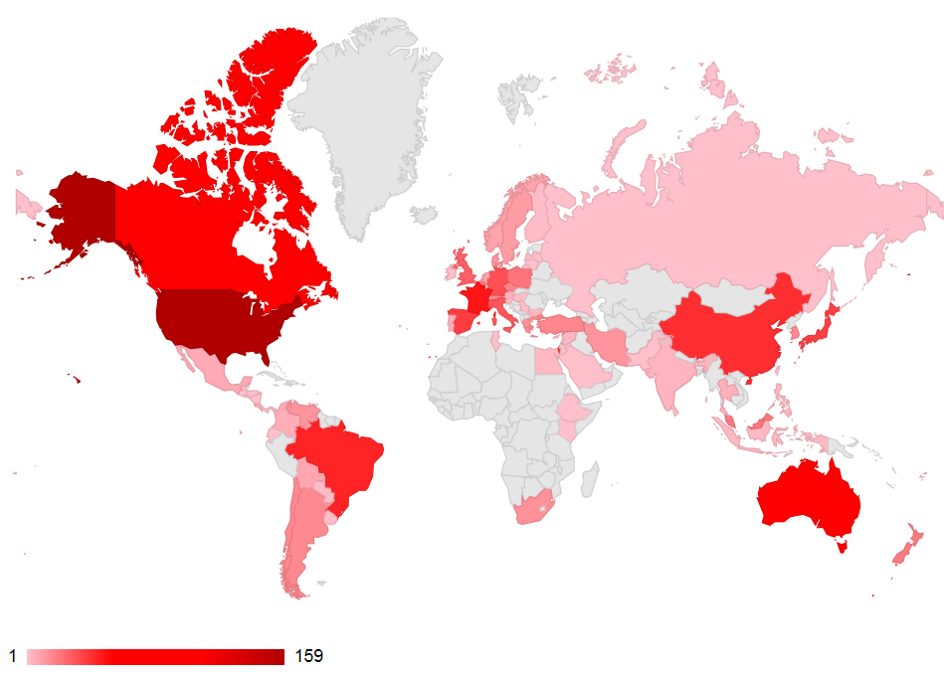

Herbicide Resistance cases in Asia
http://weedscience.org

Slide 4
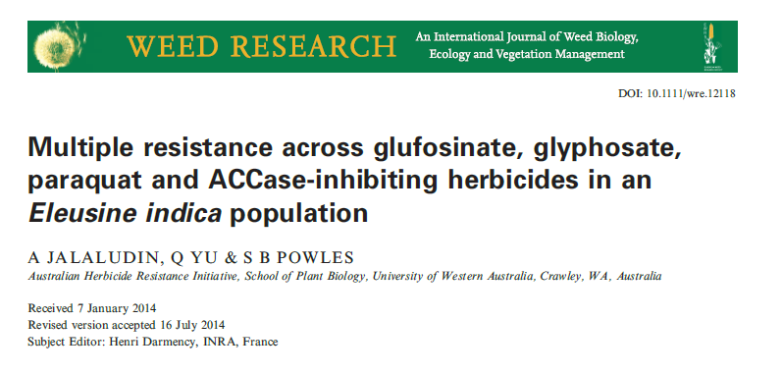
Glyphosate Resistance in Asia is not related to HT cropping systems, however raises concerns on over-reliance of glyphosate
Country | Weed Species | When declared | Situation
Australia | Lolium rigidum (rigid ryegrass) | 1996* | Canola, Cereals, Fencelines, Wheat, apples, around building, irrigation channel, alfalfa, clover, grapes, roadside railways and Pasture seed
Australia | Echinocloa colona (jungle rice) | 2007* | Cropland
Australia | Urochloa panicoides (liverseed grass) | 2008* | Sorghum and Wheat
Australia | Chloris truncata (windmill grass) | 2010* | Cropland
Australia | Raphanus raphanistrum (wild Radish) | 2010* | Fallow
Australia | Conyza bonariensis (hairy fleabane) | 2010 | Cropland, Industrial sites, and Roadsides
Australia | Bromus diandrus (ripgut Brome) | 2011* | Fenceline and wheat
Australia | Brachiaria eruciformis (sweet Summer Grass) | 2014* | Fallow
Australia | Bromus rubens (Red Brome) | 2014* | Fallow
Australia | Sonchus oleraceus (annual Sowthistle) | 2014* | Cotton and fallow
Malaysia | Eleusine Indica (goosegrass) | 1997* | Orchards
Malaysia | Hedyotis verticillata (woody borreria) | 2005 | Oil palm plantation
China | Conyza canadiensis (horseweed) | 2006 | Orchards
China | Eleusine Indica (goosegrass) | 2010 | Cotton and Citrus
New zealand | Lolium perenne (Perennial Ryegrass) | 2012 | Grapes
Japan | Lolium perenne ssp. multiflorum (Italian Ryegrass) | 2011 | Rice Paddy Levee
Japan | Eleusine Indica (goosegrass) | 2013 | Rice Paddy Levee
Japan | Conyza canadiensis (horseweed) | 2014 | Railways

Slide 5







HRAC Asia Organization
HRAC Asia is being formed with eight companies members (Australia and Japan have their own HRAC entities).
It will consist of a regional coordinating group leading from Singapore (in concert with the guidance from Global HRAC) with few representatives located in other countries of the region.

Slide 6
HRAC Asia representatives
Name | Company | Status
Edson Begliomini | BASF
Venay Sharma | Bayer | Confirmed
Brendan Ahem | Dupont Pioneer
Oliver Paige | Dow | Confirmed
Fong Wen Shyaun | Sumitomo | Confirmed
Kumar Vankayala | FMC | Confirmed
Vino Shivrain | Syngenta | Confirmed
Luis Camacho | Monsanto | Confirmed
Crop Life Chairs: Sonny Tabata and Andrew Roberts

Slide 7

Mission
Facilitate communication and education on herbicide resistance
Promote the development and facilitate the implementation of herbicide resistance management strategies to preserve herbicides and herbicide tolerant traits for sustained use.

Slide 8
Objectives:
Advocate the use of mode of action labelling, and where appropriate, the use of alternations or mixtures for resistance management, as well as combinations of technologies such as traits and pesticides
Establish network and collaborate with regional experts for the identification and confirmation of herbicides resistance weed
Promote best management practices: highlight the dangers of applying incorrect doses, incorrect application timings and using illegal/counterfeit products in which the dose/efficacy is unknown
Support, implement and, if necessary sponsor research work to make progress in the understanding of resistance and how it can be managed or mitigated
Promote public and private herbicide-resistant weed monitoring programs for early detection and to monitor the scope of the problem.
Communicate herbicide resistance management strategies and support their implementation through technical recommendations.

Slide 9
Priorities
Define regional governance to enable efficient and effective coordination of the network
Leveraging partnership opportunities and utilize existing network capacity
Asian Pacific Weed Science Society
Weed Science Society of Republic of China (WSSROC, Taiwan)
Identify key priorities in the region
Develop strategy and rolling out plans
Establish key performance indicators that are continuously monitored and measured

Slide 10
What support do we need from GHRAC?
Foster awareness of the importance of HRAC in Asia and the impact in the countries:
limited capabilities of company resources within each country in Asia - in terms of expertise and/or broad leadership of the issues
Share learnings from other geographies operating in similar situation – eg Europe
Access to GHRAC capacity building material to promote best management practices
Recommendations on how should we involve the generic industry in the implementation of best management initiatives

Slide 11
Thank You

