Slide 1

Brazilian Association for the Action of Weed Resistance to Herbicides (HRAC-BR)
Caio Vitagliano Santi Rossi
(Dow AgroSciences)
cvrossi@dow.com
HRAC-BR Chair
Global HRAC Meeting
14th may 2017
Denver - CO

Slide 2













HRAC-BR Associated Companies

Slide 3
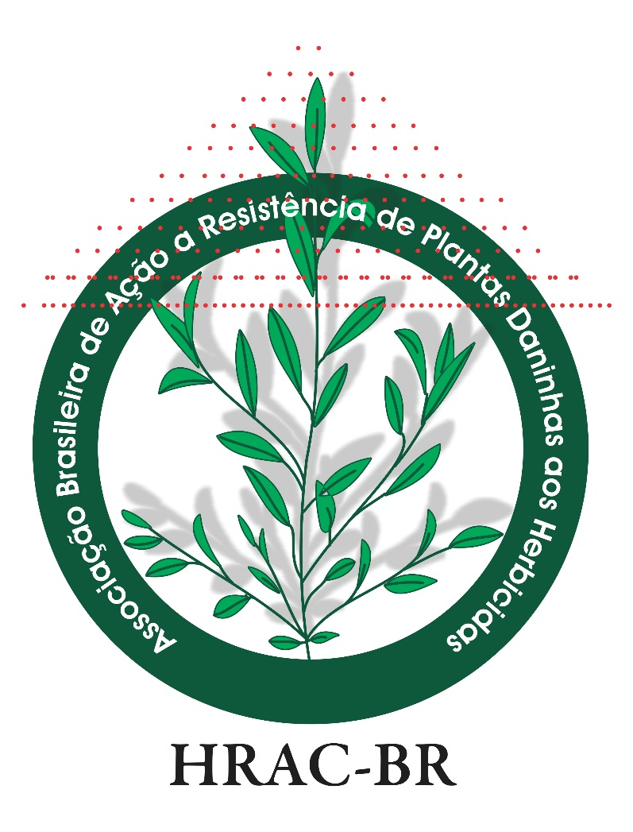
HRAC-BR Associated Companies
2017/2018
Caio Rossi – Dow AgroSciences (Chair)
Luciano Almeida (Lawyer)
Samuel Neves – Du Pont (Secretary)
Fernando Gava – BASF (Technical Affairs VP)
Marcel Melo BAYER (Educational Affairs VP)
Roberto Toledo - Ourofino (Communications & MKT VP)
Silvio Furuhashi – ISK (Treasurer)

Slide 4
HRAC-BR: Mission and Objectives
Mission:
Monitoring the progress of Herbicide-Resistant Weeds, assessing the impact of these plants and promoting the effective management of weed resistance, mitigating and enhancing the teaching, research and extension in order to integrate the different sectors such as universities and official institutions and private, Agrochemical Industries, Cooperatives, Farmers and Dealers.
Objectives:
Promoting the RESPONSIBLE use of herbicides, Weed Resistance PREVENTION and define INTEGRATED MANAGEMENT STRATEGIES for HERBICIDE-RESISTANT WEEDS.

Slide 5
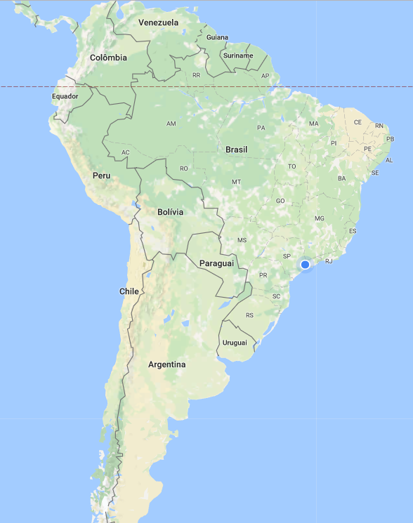
Brazilian Crop Area

Slide 6

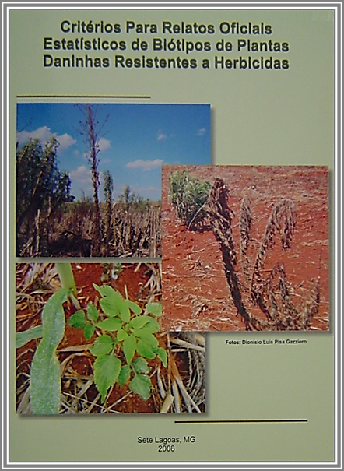
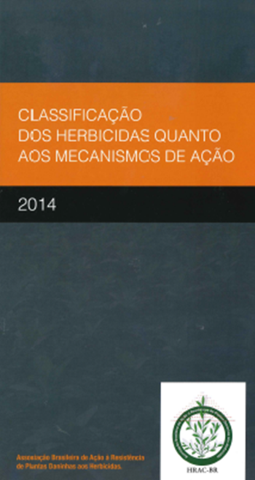
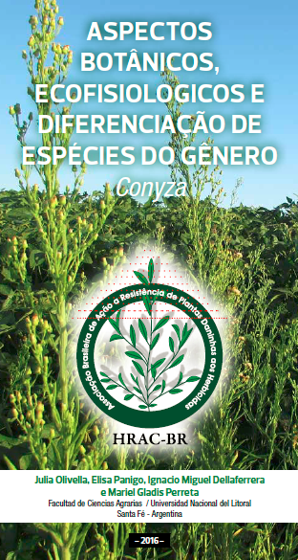
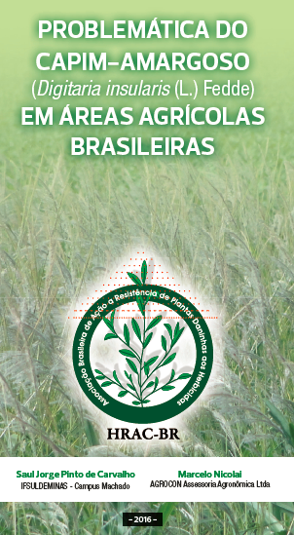
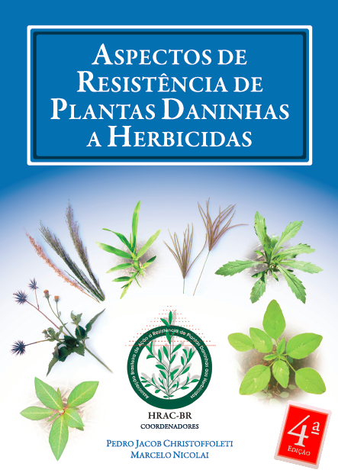
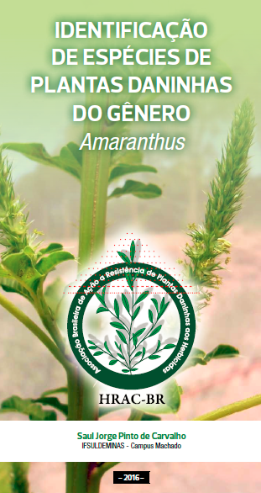
HRAC-BR: latest publications and important
Book, re-edition

Slide 7
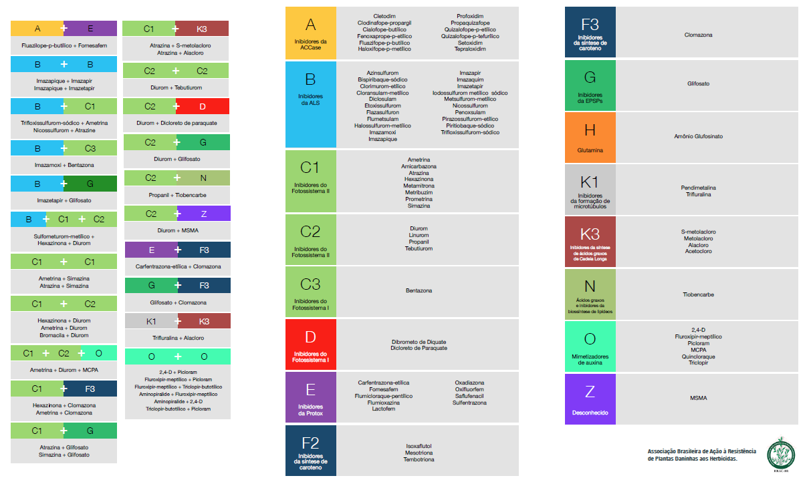
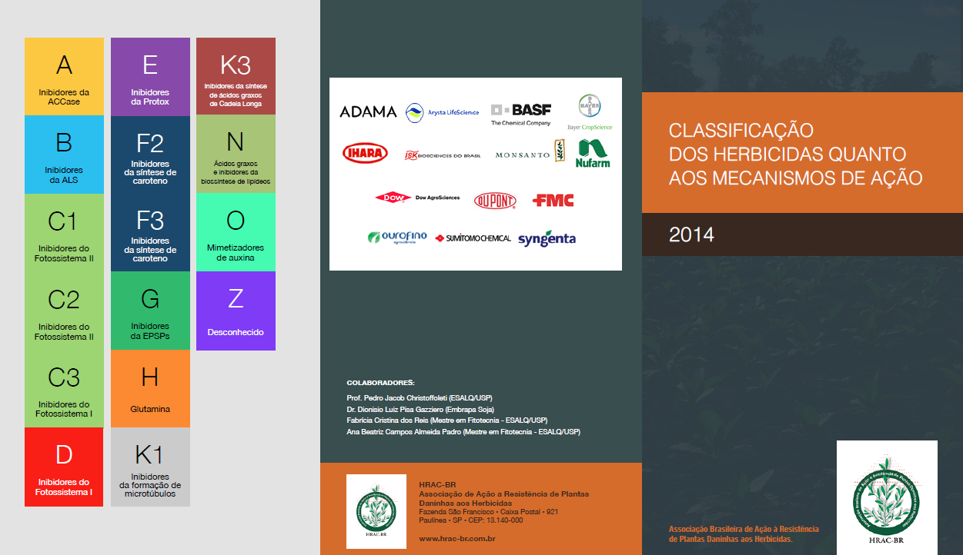
HRAC-BR: MOA Herbicides Classification

Slide 8
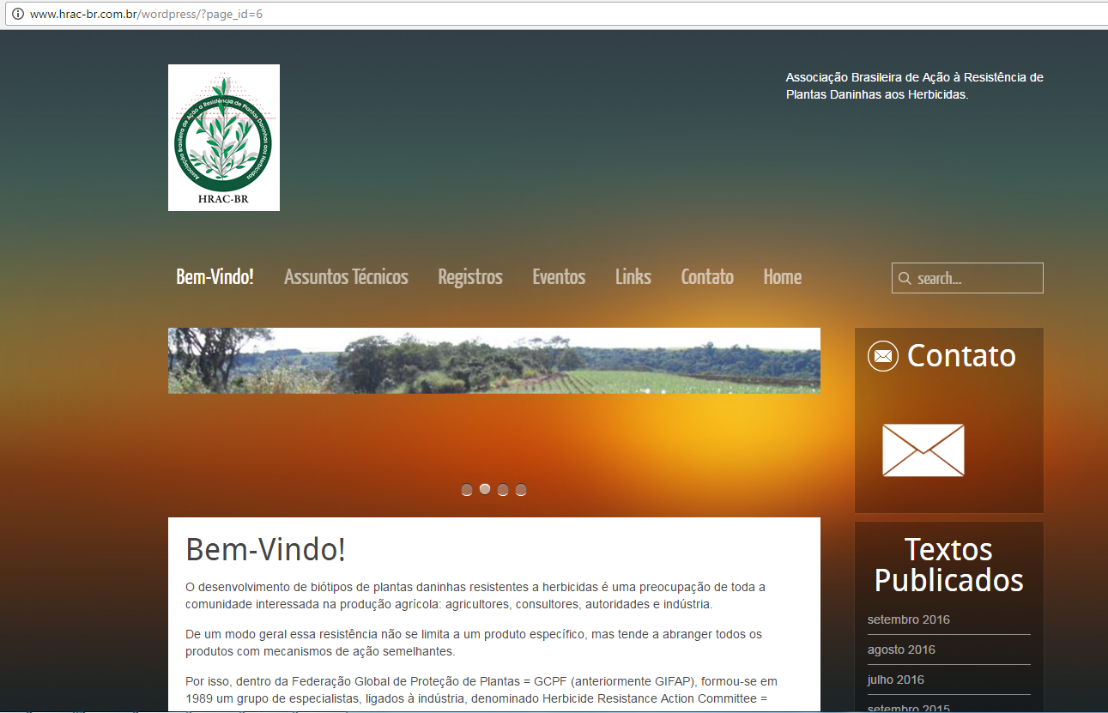
HRAC-BR: Official Site and Social Media
http://www.hrac-br.com.br
Facebook:
https://www.facebook.com/hrac.brasil
Linkedin:
http://br.linkedin.com/pub/hrac-brasil/54/103/448
Plans to restructure the site and tools.

Slide 9
HRAC-BR: Partnership and Collaborators
On going:
SBCPD: Brazilian Society of Weed Science
ANDEF: National Association of Plant Protection
EMBRAPA
Several Universities
Start Talking and taking actions:
CropLife
Cib: Council of Information on Biotechnology – WRM (Weed Resistance Manager)

Slide 10
HRAC-BR: Latest Educational and MKT/Communication Actions in Weed Resistance Events
II Herbicide Resistant Weeds Colloquium in Jaboticabal/SP;
I Integrated Weed Management and Herbicide Resistant Crop Symposium in Uberlândia/ MG;
III; IV and V Herbicides Weed Resistance National Meeting in Passo Fundo/ RS;
III Pests, Weeds and Fungi Resistance to Agrochemical Products Symposium in Rio Verde/ GO;
III HRAC-BR Workshop during XXX Weed Science Brazilian Congress;

Slide 11
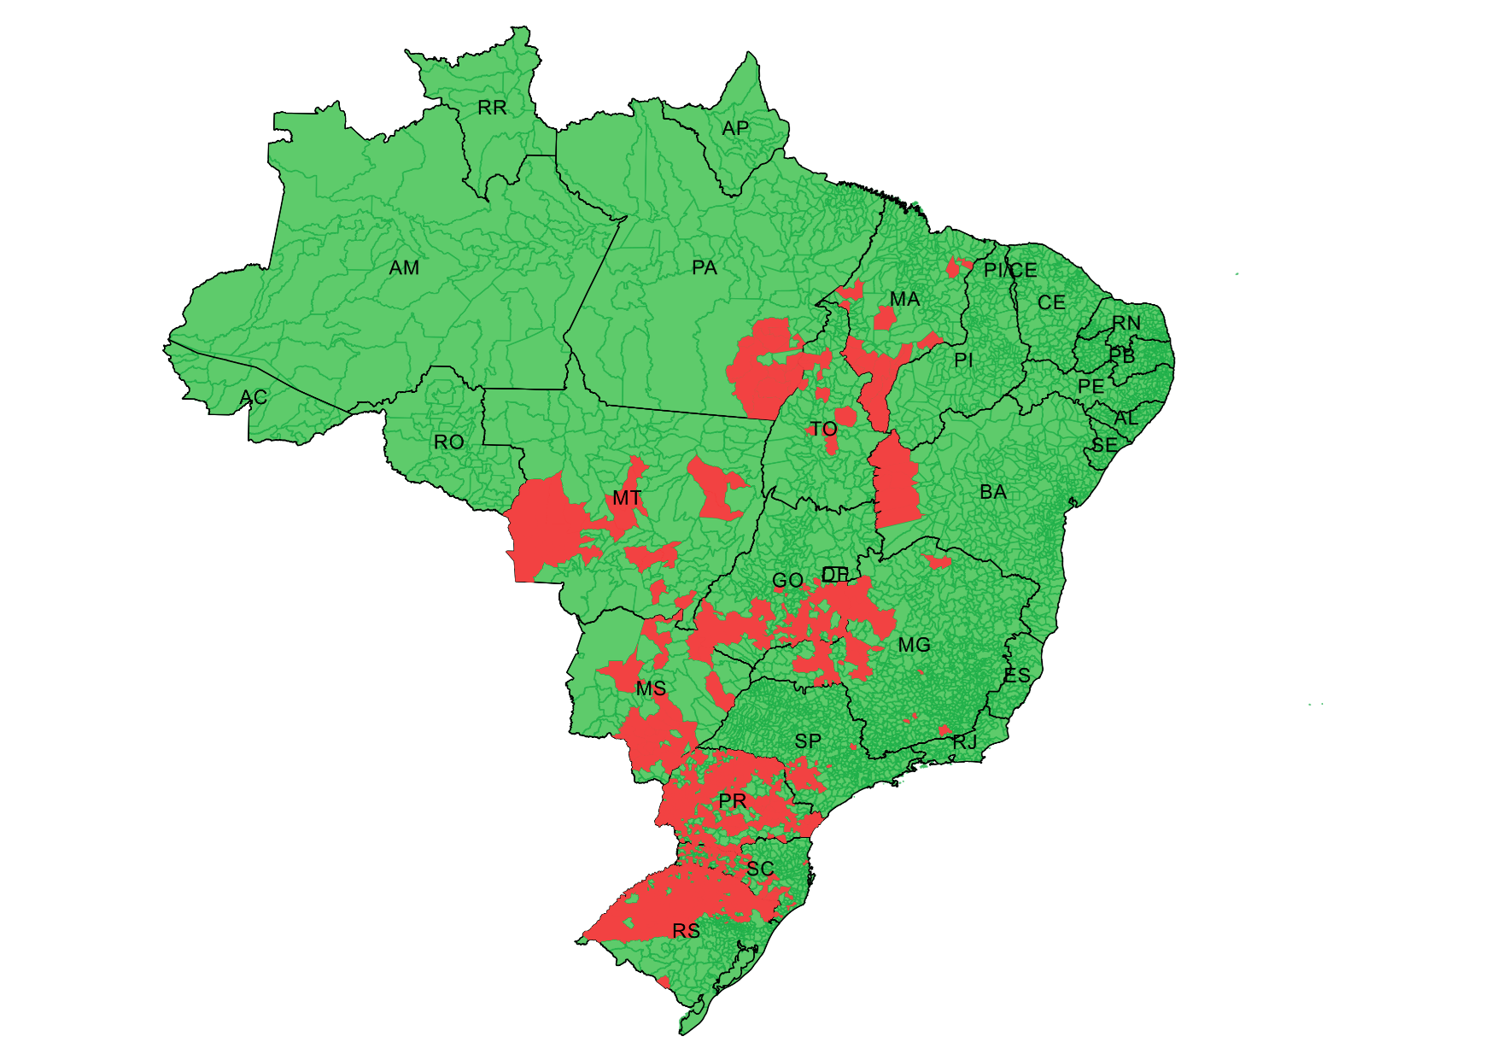
HRAC-BR: Map of Resistance (EPSPs) in Brazil
A. palmeri
± 13 M ha
Conyza sp. (horseweed)
Digitaria insularis (sourgrass)
Conyza sp. (horseweed)
Digitaria insularis (sourgrass)
Lolium perenne spp. multiflorum (Italian ryegrass)
Conyza sp. (horseweed)
Lolium perenne spp. multiflorum (Italian ryegrass)
Source: Leandro Vargas, 2017.

Slide 12
HRAC-BR: Current Technical Projects
Identification of potential resistance cases of Euphorbia heterophylla populations to the glyphosate herbicide in “Rio Grande do Sul” in Brazil. This project is being conducted in partnership with Embrapa Wheat and the Federal University of Pelotas (UFPel);
Susceptibility of Eleusine indica populations, known as goosegrass, to ACCase inhibitors (grass herbicides) and glyphosate collected in the Mato Grosso state in Brazil, a project with the University of Várzea Grande (UNIVAG);
Ecophysiology studies of Digitaria insularis (Sourgrass) glyphosate resistant, in order to obtain indices of weed competition in soybean and corn, as well as understanding of ecophysiological parameters of development of D. insularis, from the relation of leaf area and phenological stage, a project with EMBRAPA Soja Londrina, Parana State in Brazil.

Slide 13
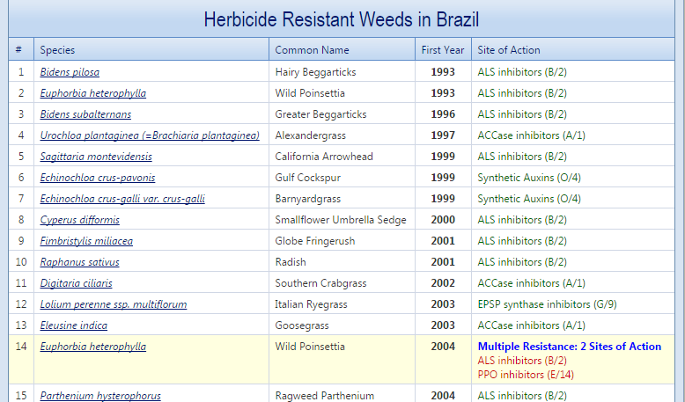
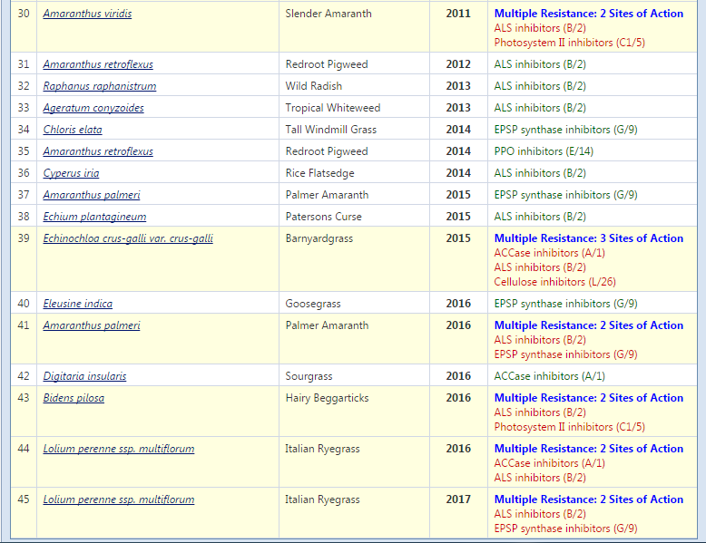
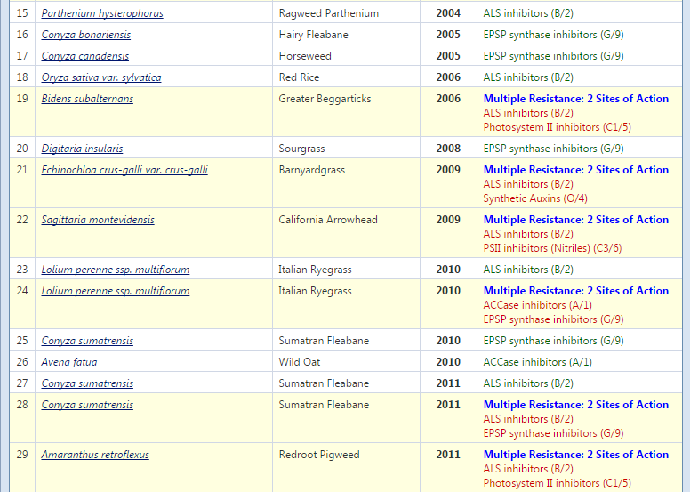
Latest Resistance Reports - http://www.weedscience.org
Heap, 2017

Slide 14
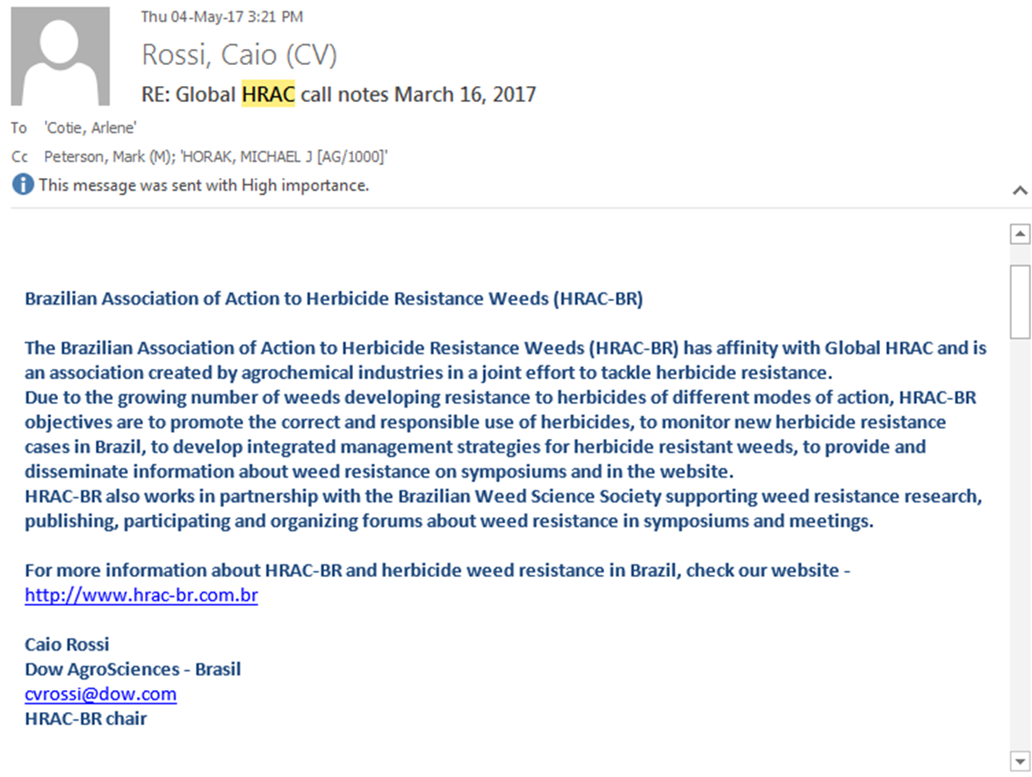
What GHRAC can do to assist HRAC-BR actions and needs?
Proximity fortification with HRAC-BR, affinity recognition from Brazilian researchers;
Link HRAC-BR in site of GHRAC;
Information of HRAC-BR as Regional HRACs (sent email to responsible); ➔➔➔
Unify communication of information, messages and resistance strategies;
Alignment of Resistance Management. How to treat in effective way? Communications, Social Medias… Is there possible to have a material build from HRACs?
Resistance Identification Cases and Criteria: How should the HRAC position itself in relation to a new reported case?
In our site (HRAC-BR) we planning to have English language to better access. Is this relevant?
Our HRAC-BR has working in Committees, is the way GHRAC works in Working Groups effective? In the work groups are information exchange or there are work actions, how companies operate (all companies are participants);

Slide 15
Thanks to - Global HRAC - Regional HRACs - All Colleagues

