Slide 1
International Survey of Herbicide Resistant Weeds
Puerto Rico 2016

Slide 2
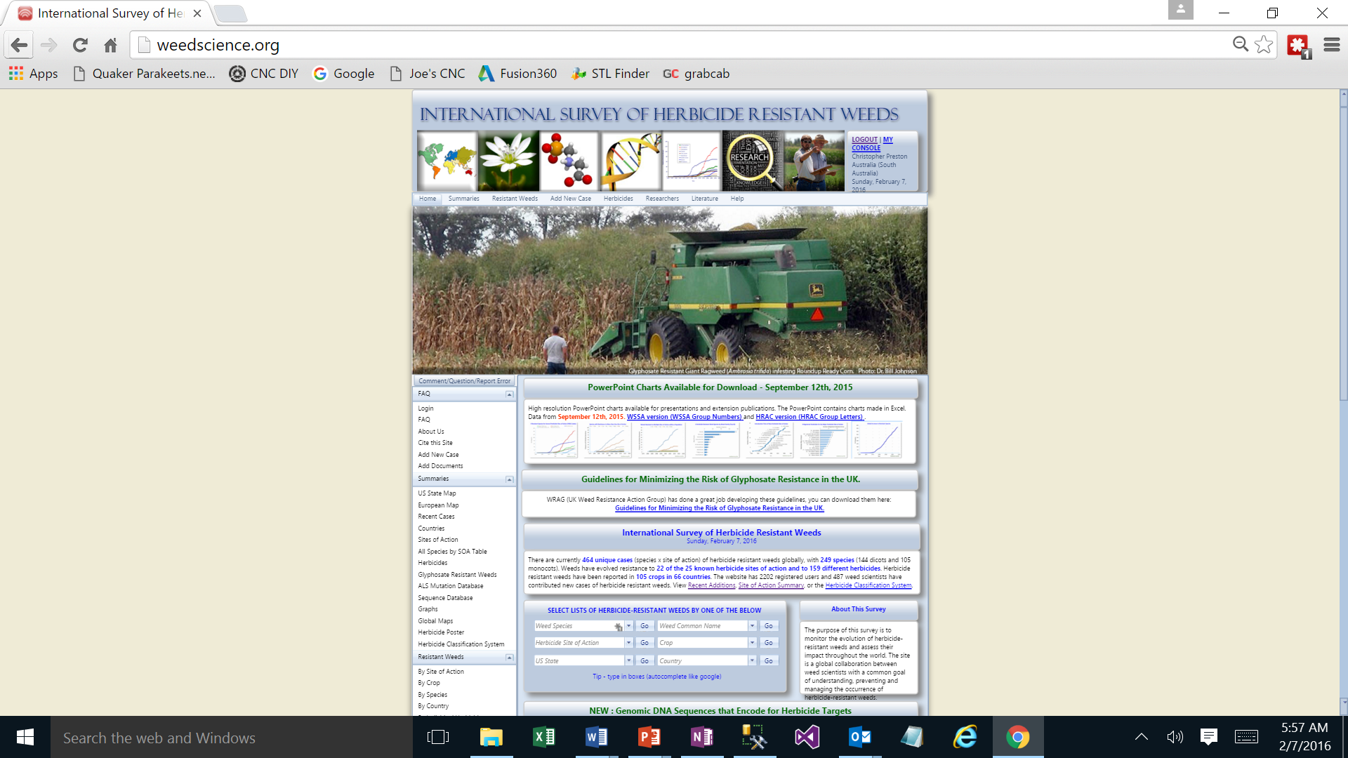
New Cases
144 additions to the site in 2015
83 new registrations
Go to recent additions
New Glyphosate cases
Chloris virgate (Feather Fingergrass)
Lactuca serriola (Prickly Lettuce)
Both in Australia, reported by Chris Preston

Slide 3
25th Asian Pacific Weed Conference
Attended in Hyderabad, India - October 2015
Gave a plenary presentation entitled “Herbicide Resistance – A Global Perspective”
Covered the survey and the criterion for posting information
Able to create a lot of contacts from the Asian Pacific region and helped update herbicide resistance research on the survey

Slide 4
4 Main Modules Under Development
Mechanisms
Genetics
Multiple Resistance
Weed Biology

Slide 5
From: julie vaillancourt [mailto:julie.vaillancourt@radio-canada.ca] Sent: Tuesday, November 10, 2015 3:15 PM To: IanHeap@weedscience.org Subject: question
Hi Mr Heap,
On your website, I count 26 states in wich we find some Palmer amaranth.
But Larry Steckel, who is a Tennesse's specialist told me that there is some Palmer also in California.
Is it possible?And how come I don't find California on your list?
Best regard
Julie Vaillancourt Journaliste Société Radio-Canada
bureau 514-597-5250
cell. 514-895-5391

Slide 6
From: Ian Heap [mailto:IanHeap@weedscience.org] Sent: Tuesday, November 10, 2015 9:44 PM To: 'julie vaillancourt' <julie.vaillancourt@radio-canada.ca> Subject: RE: question
Yes, it is possible, even very likely. However, the scientific data to show resistance has not been submitted to the site so that we can post it. Otherwise the site wouldn’t be scientific, just people’s opinions. Don’t worry, California will appear on the website as soon as we get scientific confirmation.
Ian Heap.
**************************************************************
Ian Heap Ph.D.
International Survey of Herbicide
Resistant Weeds
P.O. Box 1365
Corvallis, OR 97339 USA
Ph: 541 231-4921
E-mail : IanHeap@weedscience.org
URL : http://www.weedscience.com
**************************************************************
"Aussie Enjoying Oregon"

Slide 7
Where did Larry Steckel get his information?
”To that list, junglerice has recently been added with confirmed instances from Kern to Colusa counties, and even more recently, Palmer amaranth has been coming through glyphosate treatments in Tulare County, according to Extension weed specialist Brad Hanson, UC Davis, speaking at The Almond Conference last December.” Western Farm Press
Brad Hanson mentioned in his talk to Almond growers that Palmer Amaranth had been “coming through glyphosate treatments”

Slide 8
Posting Common Cases – we still need a scientific process
Sometimes receive comments that the survey is “out of date” because it does not include a species x with resistance to herbicide y in state z.
With widespread cases like glyphosate resistant Palmer Amaranth it is logical to assume that it occurs in all states that a) have a lot of Palmer Amaranth and b) have a lot of Roundup Ready crops
That’s fine, but the survey is not about assumption, it is about facts. In the above case no-one would blink if suddenly glyphosate resistant Palmer Amaranth appeared in a new state, however where do you draw the line. The survey cannot be based on assumption or it all falls apart.
For this reason I believe I have to just accept that some people think the survey is “not up to date”.
The survey strives to be up to date with what is actually scientifically known and shown to be resistant.

Slide 9
Even Difficult with Experienced Researchers
From: Jason Keith Norsworthy [mailto:jnorswor@uark.edu] Sent: Monday, April 6, 2015 11:09 AM To: IanHeap@weedscience.org Subject: resistant barnyardgrass
Ian,
I have a population of barnyardgrass in AR that has tested positive for resistance to propanil, imazethapyr, penoxsulam, quinclorac, and cyhalofop (four sites of action).
Please add this to your website.
Jason K. Norsworthy
Professor and Elms Farming Chair of Weed Science
University of Arkansas
1366 West Altheimer Drive
Fayetteville, AR 72704
Cell: 479-445-9310
Office: 479-575-8740
Fax: 479-575-3975

Slide 10
From: Ian Heap [mailto:IanHeap@weedscience.org] Sent: Monday, April 06, 2015 3:08 PM To: Jason Keith Norsworthy Subject: RE: resistant barnyardgrass
Thanks Jason, can you send me a bit of information about
The year it was collected and the county
The type of tests that were done and a table or dose response curve for each of the herbicides (I don’t make that public, but I need it to post the case)
The crop(s) that it was found in – rice I guess
The people you want listed as contributors
Cheers
Ian Heap.
**************************************************************
Ian Heap Ph.D.
International Survey of Herbicide
Resistant Weeds
P.O. Box 1365
Corvallis, OR 97339 USA
Ph: 541 231-4921
E-mail : IanHeap@weedscience.org
URL : http://www.weedscience.com
**************************************************************
"Aussie Enjoying Oregon"

Slide 11
From: Jason Keith Norsworthy [mailto:jnorswor@uark.edu] Sent: Monday, April 6, 2015 1:10 PM To: IanHeap@weedscience.org Subject: RE: resistant barnyardgrass
It may be next week before I can get this to you.
From: Ian Heap [mailto:IanHeap@weedscience.org] Sent: Monday, April 13, 2015 11:10 AM To: 'Jason Keith Norsworthy' <jnorswor@uark.edu> Subject: RE: resistant barnyardgrass
Hi Jason,
Looking forward to getting the multiple resistant barnyardgrass up.
I didn’t want to discourage you, it doesn’t matter what format the data is in.
Cheers

Slide 12
From: Jason Keith Norsworthy [mailto:jnorswor@uark.edu] Sent: Monday, April 13, 2015 12:39 PM To: <IanHeap@weedscience.org> Subject: Re: resistant barnyardgrass
I'm out of town this week.
Regards,
Jason
Sent from my iPhone

Slide 13
From: Ian Heap [mailto:IanHeap@weedscience.org] Sent: Wednesday, May 27, 2015 2:42 PM To: 'Jason Keith Norsworthy' <jnorswor@uark.edu> Subject: RE: resistant barnyardgrass
Hi Jason,
No doubt you are in the field a lot right now. Just wondering if you had a chance to get the multiple resistant barnyardgrass confirmation data, I would like to post it.
I really don’t need a lot from you because you know what you are doing, but I do need a table or graph showing resistance.
Cheers
Ian Heap.
**************************************************************
Ian Heap Ph.D.
International Survey of Herbicide
Resistant Weeds
P.O. Box 1365
Corvallis, OR 97339 USA
Ph: 541 231-4921
E-mail : IanHeap@weedscience.org
URL : http://www.weedscience.com
**************************************************************
"Aussie Enjoying Oregon"

Slide 14
From: Jason Keith Norsworthy [mailto:jnorswor@uark.edu] Sent: Thursday, May 28, 2015 3:27 AM To: <IanHeap@weedscience.org> Subject: Re: resistant barnyardgrass
I need to get you something but I'm rarely in the office these days. The summer months are extremely hectic.
Regards,
Jason
Sent from my iPhone

Slide 15
From: Ian Heap [mailto:IanHeap@weedscience.org] Sent: Thursday, May 28, 2015 11:30 AM To: 'Jason Keith Norsworthy' <jnorswor@uark.edu> Subject: RE: resistant barnyardgrass
No problem, I will check back in a month or two. How’s the seed destructor going? Looking like a commercial viability for your growers?
Cheers
Ian Heap.
**************************************************************
Ian Heap Ph.D.
International Survey of Herbicide
Resistant Weeds
P.O. Box 1365
Corvallis, OR 97339 USA
Ph: 541 231-4921
E-mail : IanHeap@weedscience.org
URL : http://www.weedscience.com
**************************************************************
"Aussie Enjoying Oregon"

Slide 16
From: Ian Heap [mailto:IanHeap@weedscience.org] Sent: Thursday, August 28, 2015 8:30 AM To: 'Jason Keith Norsworthy' <jnorswor@uark.edu> Subject: RE: resistant barnyardgrass
Hi Jason, do you have the data on the multiple resistant barnyardgrass?
Cheers
Ian Heap.
**************************************************************
Ian Heap Ph.D.
International Survey of Herbicide
Resistant Weeds
P.O. Box 1365
Corvallis, OR 97339 USA
Ph: 541 231-4921
E-mail : IanHeap@weedscience.org
URL : http://www.weedscience.com
**************************************************************
"Aussie Enjoying Oregon"

Slide 17
Open Access Papers
Future of scientific publishing going towards open access
Different versions of open access
Free to read
Free to reuse and distribute
I have a collection of herbicide resistance papers that are open access
I would like to include PDF’s of open access papers (free to reuse) linked to specific herbicide resistance cases, as well as making their full text searchable.
IS HRAC OK FOR ME TO DO THIS?

Slide 18
HRAC Website Handoff?
HRAC website to be managed elsewhere
Need to transfer domain name www.hracglobal.com
Choose who will be in charge of the domain name
Transfer of the website to new team
When is this going to happen?

