Slide 1


Global Herbicide Resistance Action Committee (HRAC)
January 17, 2017
Protecting crop yields and quality worldwide

Slide 2


Who We Are
A global leader on weed resistance
Notes:
The global agriculture community is marshalling an army to meet the challenge of herbicide resistant weeds and we see our role as the army’s Signal Corps. Its coordinators and communicators. No matter where on the planet a battle is fought, our role is to provide the information necessary to wage and win it. We are this generation’s eyes, ears and voice, collecting assessing and sharing best management practices. Global HRAC strives to be the world leader in addressing this important issue.

Slide 3

What We Do
We collect, assess and provide the information necessary to prevent
and take action against herbicide resistance.

Slide 4

Our Audience:
Grower Influencers
These are industry experts who work directly
with farmers.
They could be salespeople, ag advisors, extension experts, retail agronomists, government agents, distributors, and so on.
Regional HRACs
These are mostly weed scientists.
We coordinate and support regional offices with the resources they need to educate farmers, agronomists and industry members.

Slide 5

Our Mission
We support the efforts of those at the farm gate, helping them educate growers on how to confront weed resistance more effectively.
Our Purpose
To preserve the efficacy of herbicides and their crucial role in helping humanity feed itself.

Slide 6
Our Working Groups:
Auxin | HPPD | Communications | Issues Engagement
Facilitating the exchange of information and BMPs related to auxin-resistant weeds among technical stakeholders | Facilitating the exchange of information and BMPs related to HPPD-resistant weeds among technical stakeholders | Providing current technical information about weed resistance to target audiences | Evaluate resistance-related discussions in the public domain and develop science-based information
Your participation and input is welcome!

Slide 7

Website Working Group:
Arlene Cotie
Roland Beffa
Dawn Refsell
Bob Masters
Bo Braxton
Andreas Landes
Gael le Goupil

Slide 8

2016 Accomplishments:
Global HRAC brand story and identity
  Templates for logo’s, powerpoint, poster
Website launch
  Reviewed and update all info
  Launched new Global Herbicide Lookup Tool

Slide 9
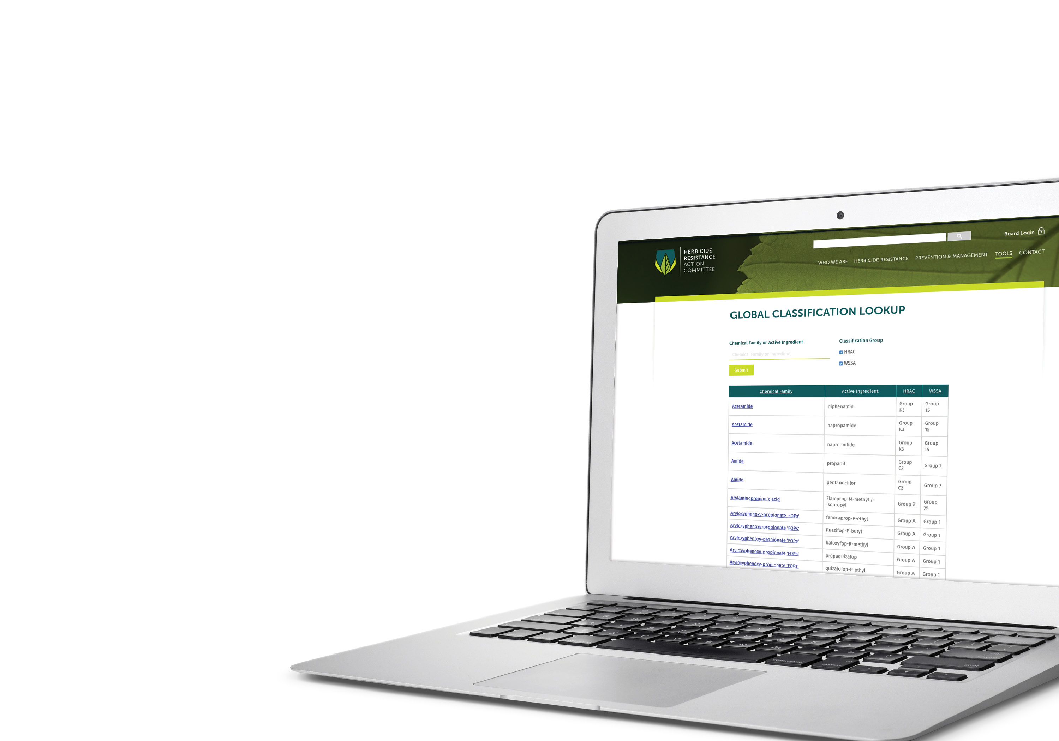
2017 – 2018 Initiatives:
Building a communication strategy
Request New Herbicides Classification
  aligned with WSSA
Website content review
  update BMP’s
  include Australian classification
Agreement with Ian Heap
  Succession planning
Request from EHRAC to incorporate regional RAC’s

Slide 10

Thanks for your
kind attention

Slide 11

This is a heading
This is a subheading.
This is body copy.

Slide 12
Global HRAC is an industry-based group administered by CropLife International.
Our Members: | Our Staff:
Arysta LifeScience BASF Bayer CropScience Dow AgroSciences DuPont Crop Protection FMC Makhteshim Agan/ADAMA Monsanto Syngenta Crop Protection Sumitomo Chemical Company | Chairman Mark Peterson of Dow AgroSciences Secretary/Treasurer Michael Horak of Monsanto Communications Lead Arlene Cotie of Bayer CropScience

