Slide 1


The Global Herbicide Resistance Action Committee – Industry Engagement and Commitment
February 7, 2017
Mark A. Peterson, Global HRAC Chair

Slide 2


Who We Are
A global leader on herbicide resistance
Notes:
Global HRAC is an Industry-based group of scientists engaged in understanding herbicide resistance and how to delay or prevent it. Companies that research, develop, and market herbicides are uniquely positioned to understand the behavior of their chemistries and the ways that they are used by farmers. This knowledge, when combined with broader understanding of weed biology and ecology, is important to developing best management practices that lead to the long-term preservation of these important weed control tools.

Slide 3

Global HRAC is an industry-based group working as a part of CropLife International.
Our Members: | Our Staff:
Arysta LifeScience BASF Bayer CropScience Dow AgroSciences DuPont Crop Protection FMC Monsanto Syngenta Crop Protection Sumitomo Chemical Company | Chairman Mark Peterson of Dow AgroSciences Secretary/Treasurer Michael Horak of Monsanto Communications Lead Arlene Cotie of Bayer CropScience
Notes:
We are a part of CropLife International and currently have representation from 9 companies. Typically each company has 2-3 representatives that participate in meetings and serve on Working Groups and/or sub-teams. The Committee has three officers, Chair, Secretary/Treasurer, and Communications Lead. The full Committee meets bi-monthly, usually by conference call but face-to-face at least twice per year.

Slide 4
Our Working Groups:
Auxin | HPPD | Communications | Issues Engagement
Facilitating the exchange of information and BMPs related to auxin-resistant weeds among technical stakeholders | Facilitating the exchange of information and BMPs related to HPPD-resistant weeds among technical stakeholders | Providing current technical information about weed resistance to target audiences | Evaluate resistance-related discussions in the public domain and develop science-based information
Your participation and input is welcome!
Notes:
Working Groups are teams of technically-oriented individuals that focus on specific areas. These may be understanding resistance in specific sites of action, such as the Auxin and HPPD working groups, or areas such as enhancing communications or developing science-based information related to current public issues. Working groups collect and analyze pertinent information, develop technical communication pieces, and organize seminars/symposia on herbicide resistance-related topics. In some cases these groups may sponsor research projects or other 3rd party efforts.
(Note to presenter: it may be helpful to verbalize some current activities for each Working Group)
Working Groups are open to both Industry and non-Industry participants. We welcome those who are interested in engaging in the discussion and direction.

Slide 5

What We Do
We collect, assess and provide the information necessary to prevent
and take action against herbicide resistance.
Notes:
Global HRAC works to be a clearing house for information on herbicide resistance that can then be used by others to develop specific strategies for managing resistance. The collective knowledge of these crop protection companies provides a unique perspective on the problem of herbicide resistance.

Slide 6
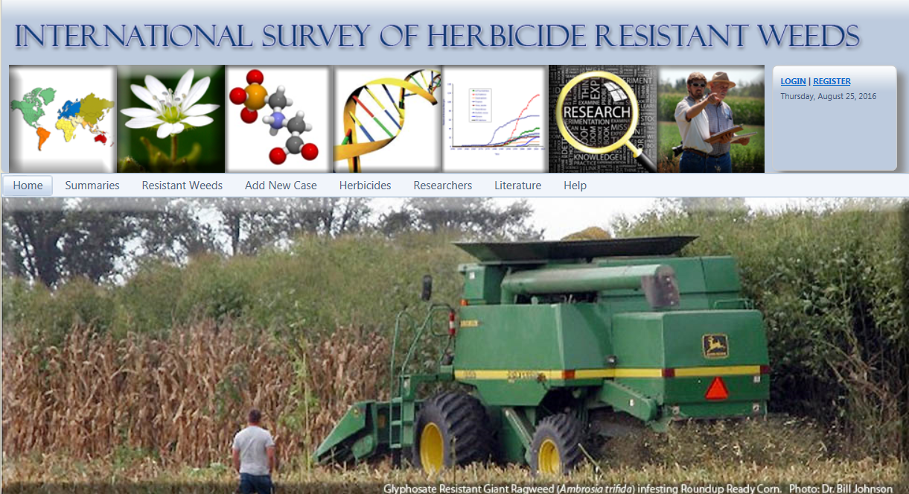
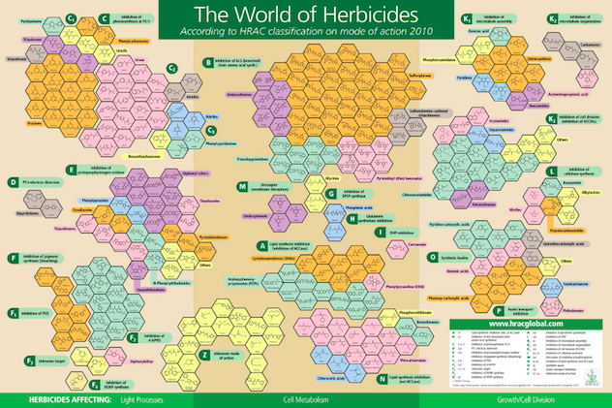
Global HRAC
Initiatives and Activities
Disseminate information on resistant weeds:
  International Survey
  HRAC Website
  Seminars and Symposia
Build recommendations:
  Working groups
  Testing protocols
Mode of Action Classification:
  Poster
  Online tool
  Coordination with other entities
www.weedscience.org
Image source/caption
Notes:
Here are some examples of the information that Global HRAC provides. These include supporting the International Survey of Herbicide Resistant Weeds, a comprehensive source of confirmed resistance cases along with other useful information related to herbicides. Additionally, GHRAC has a separate website that contains a range of information on resistance-related topics.
GHRAC organizes and supports symposia at a variety of regional and international weed science meetings.
Via the Working Groups GHRAC builds and refines best management practices and other recommendations. We also help refine resistance-testing protocols.
GHRAC has long maintained a MOA classification scheme that is used world-wide. This is communicated via our “World of Herbicides Poster” and through our online lookup tool.

Slide 7
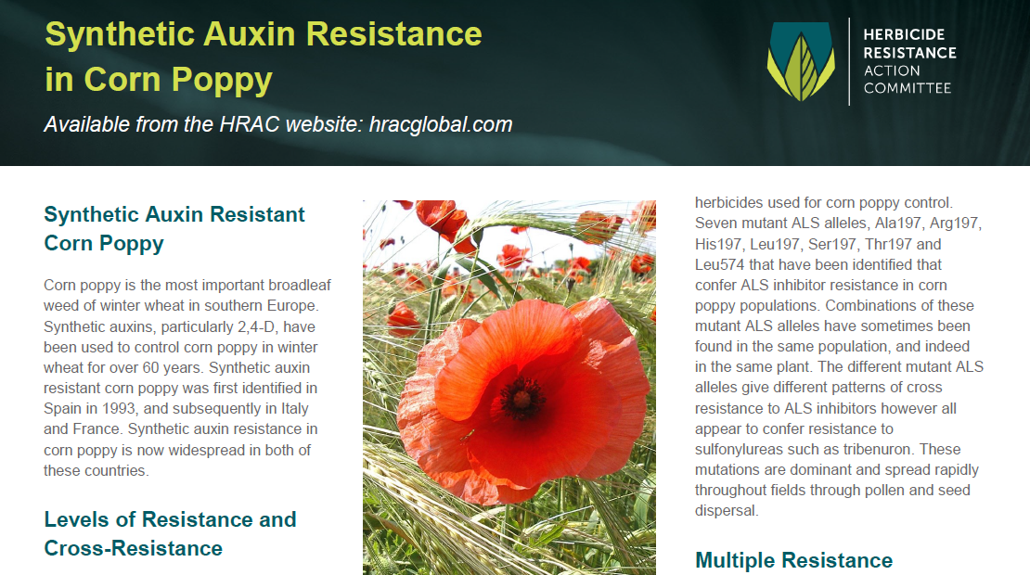
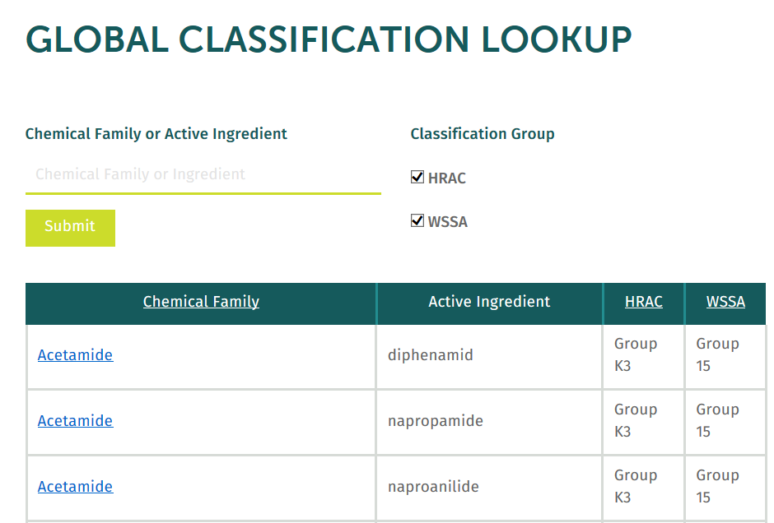
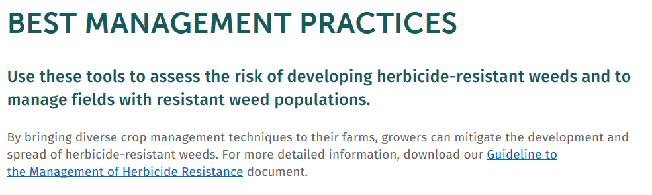
Global HRAC
Information and Education
Providing information and tools to combat resistant weeds:
Information on herbicide-resistant weeds
Tools for preventing and managing herbicide resistance
Information on herbicide Site of Action and classification
Notes:
GHRAC uses the information collected to produce fact sheets, online tools, and recommendations designed to help consultants, researchers, and educators. Semi-technical audiences such as regulators and government policy makers can look to GHRAC for information and perspectives

Slide 8

Our Audience:
Grower Influencers
These are experts who work directly
with farmers.
They could be salespeople, ag advisors, extension experts, retail agronomists, government agents, distributors, and so on.
Regional HRACs
These are Industry groups with similar objectives as Global HRAC, but are regionally or locally focused
Notes:
GHRAC focuses on communications with those that influence farmer decisions and behaviors. This would include weed science academics, extension specialists, and consultants. GHRAC also works to assist regional/country-specific HRACs in their missions related to education, communication, and working to guide public policy on herbicide resistance.
While some of the information provided by GHRAC may be useful to farmers directly, the primary effort is to assist those that spend most of their time working directly with farmers.

Slide 9
Regional HRACs
An objective of Global HRAC is to support and coordinate with regional HRACs
Provide technical information in support of local initiatives
Assist with organizational questions and setup
Provide a means to share experiences, initiatives, and challenges
Notes:
GHRAC has recently put more emphasis on working with regional/country-specific HRACs. These organizations can better understand local needs and craft information and messages that resonate within their respective geographies. GHRAC can help new regional/country-specific HRACs with setup tasks such as preparing a constitution, organizing information, and building education pieces. GHRAC meetings also provide a forum for these groups to share experiences with each other.

Slide 10
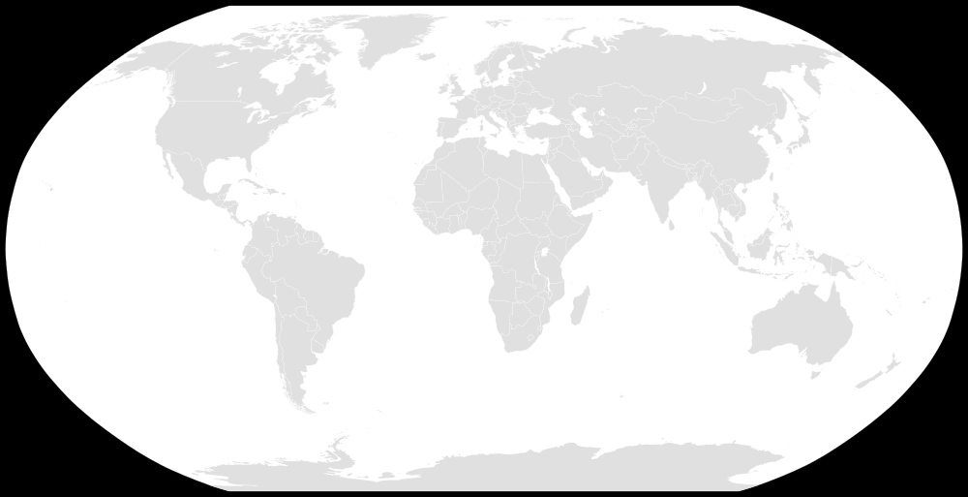
Regional and Country-specific HRACs
European HRAC
US
HRAC
Asia HRAC
Mexico HRAC
Brazil HRAC
HRMRG
Australia
Argentina HRAC
Current
Being organized
Notes:
Here are the current regional/country-specific HRACs around the world. New groups continue to form.

Slide 11

New Global HRAC Website
www.hracglobal.com
Organized information
Better search capabilities
New content
Notes:
Recently, GHRAC has redesigned and reorganized it’s website. The new site is easier to navigate and search, and contains some new content.

Slide 12
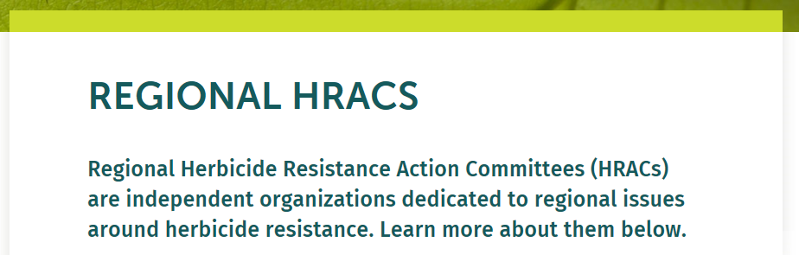
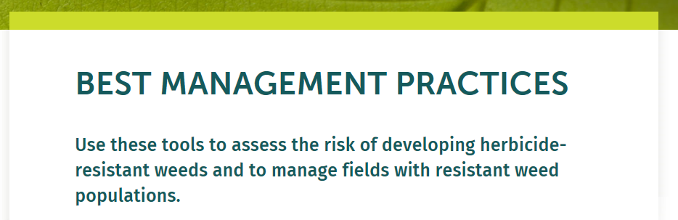
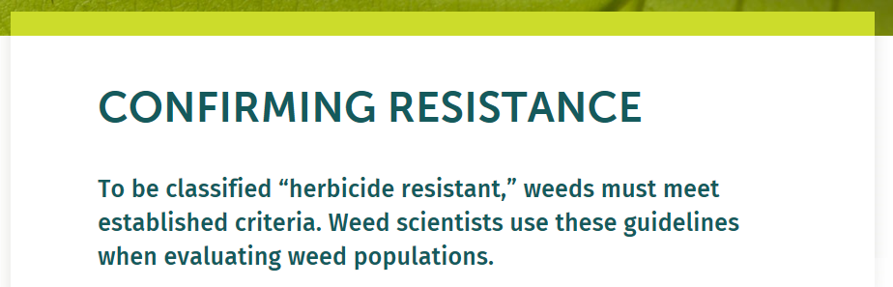
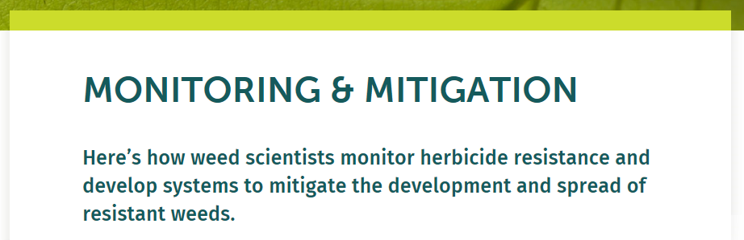
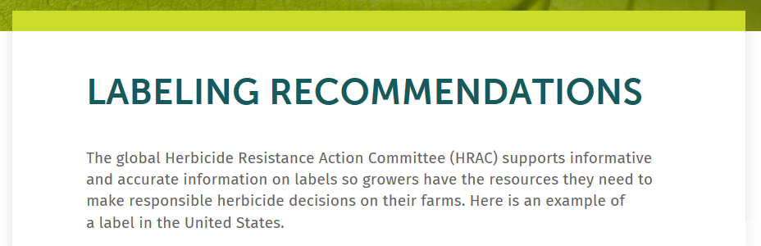
New Global HRAC Website (www.hracglobal.com)
Organized information
Better search capabilities
New content
Working to add more
Notes:
Here are examples of some of the topics you can find on the website. Our Communications Working Group continues to expand content in support of GHRAC objectives.

Slide 13

Questions?
Contact us at hracglobal.com

