Slide 1


Global HRAC Strategy Session
September 21, 2016
^{Introduction and Welcome}

Slide 2
Why are we here?
GHRAC needs to evolve to meet a changing and increasingly challenging environment
A clear, aligned Industry voice is required to:
Provide support for stewardship of our products
Provide solid information for rational, practical discussions of resistance
Become a trusted source of information and recommendations
Positively influence public policy related to resistance management

Slide 3
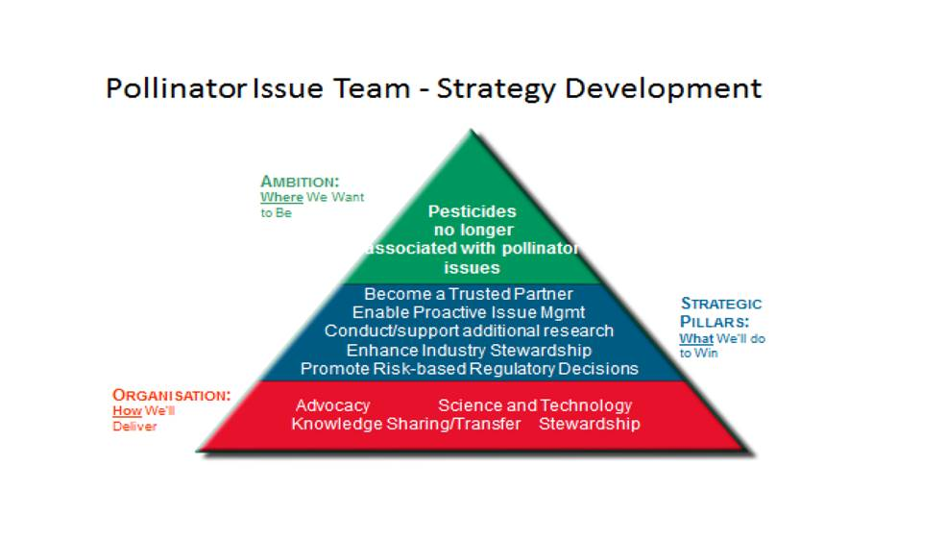
By the end of the day:
We should be clear on what we aspire to, have a clear understanding of who our audiences are, and strategic pillars that will guide our actions.
Strategy Development Output Example

Slide 4

Currently Stated MVG
per HRAC constitution

Slide 5
Mission (HRAC constitution)
HRAC mission is to maintain the effectiveness and sustainability of herbicides by coordinating and supporting research and communications to prevent and/or delay the onset of weed resistance.

Slide 6
Objectives (HRAC constitution)
To maintain the effectiveness and sustainability of herbicides by preventing and managing the development of resistance in weed populations.
To promote herbicide stewardship and best management practices with regard to weed control relative to weed resistance in order to preserve the sustainability of herbicide chemistries.

Slide 7
Goals (HRAC constitution)
To foster a responsible attitude to herbicide use.
To support and participate in research, conferences, and seminars which serve to increase our understanding of herbicide resistance.
To promote a better understanding of the causes and results of herbicide resistance.
To communicate technical herbicide resistance management strategies and support their implementation at the user level through practical guidelines.
To seek active collaboration between public and private researchers, especially in the areas of problem identification and devising and implementing management strategies.
To facilitate technical communication between industry representatives.

Slide 8
HRAC Functions (paraphrased)
Establish Working Groups and Expert Forums
Leverage information from Working Groups and other sources to:
Develop/approve recommendations, BMPs, etc.
Communicate to a variety of stakeholders
Provide a trusted, centralized source of information on resistance via websites and other tools
Engage with academics, government, distribution channel, farmers, and other organizations (public and private)

