Slide 1
Crop Protection & Plant Biotech Stewardship Review

Slide 2
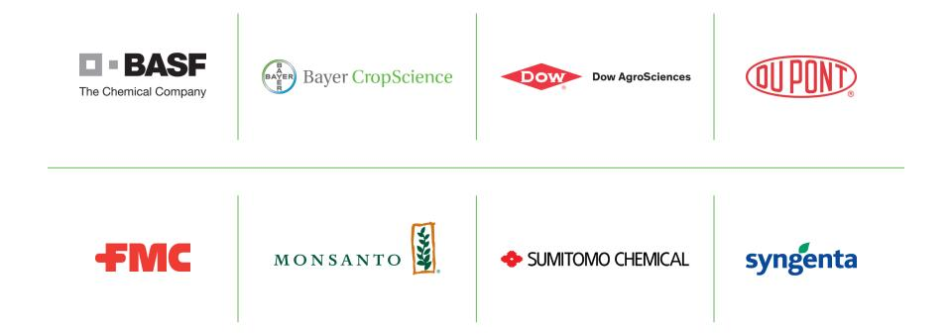
Member Companies

Slide 3
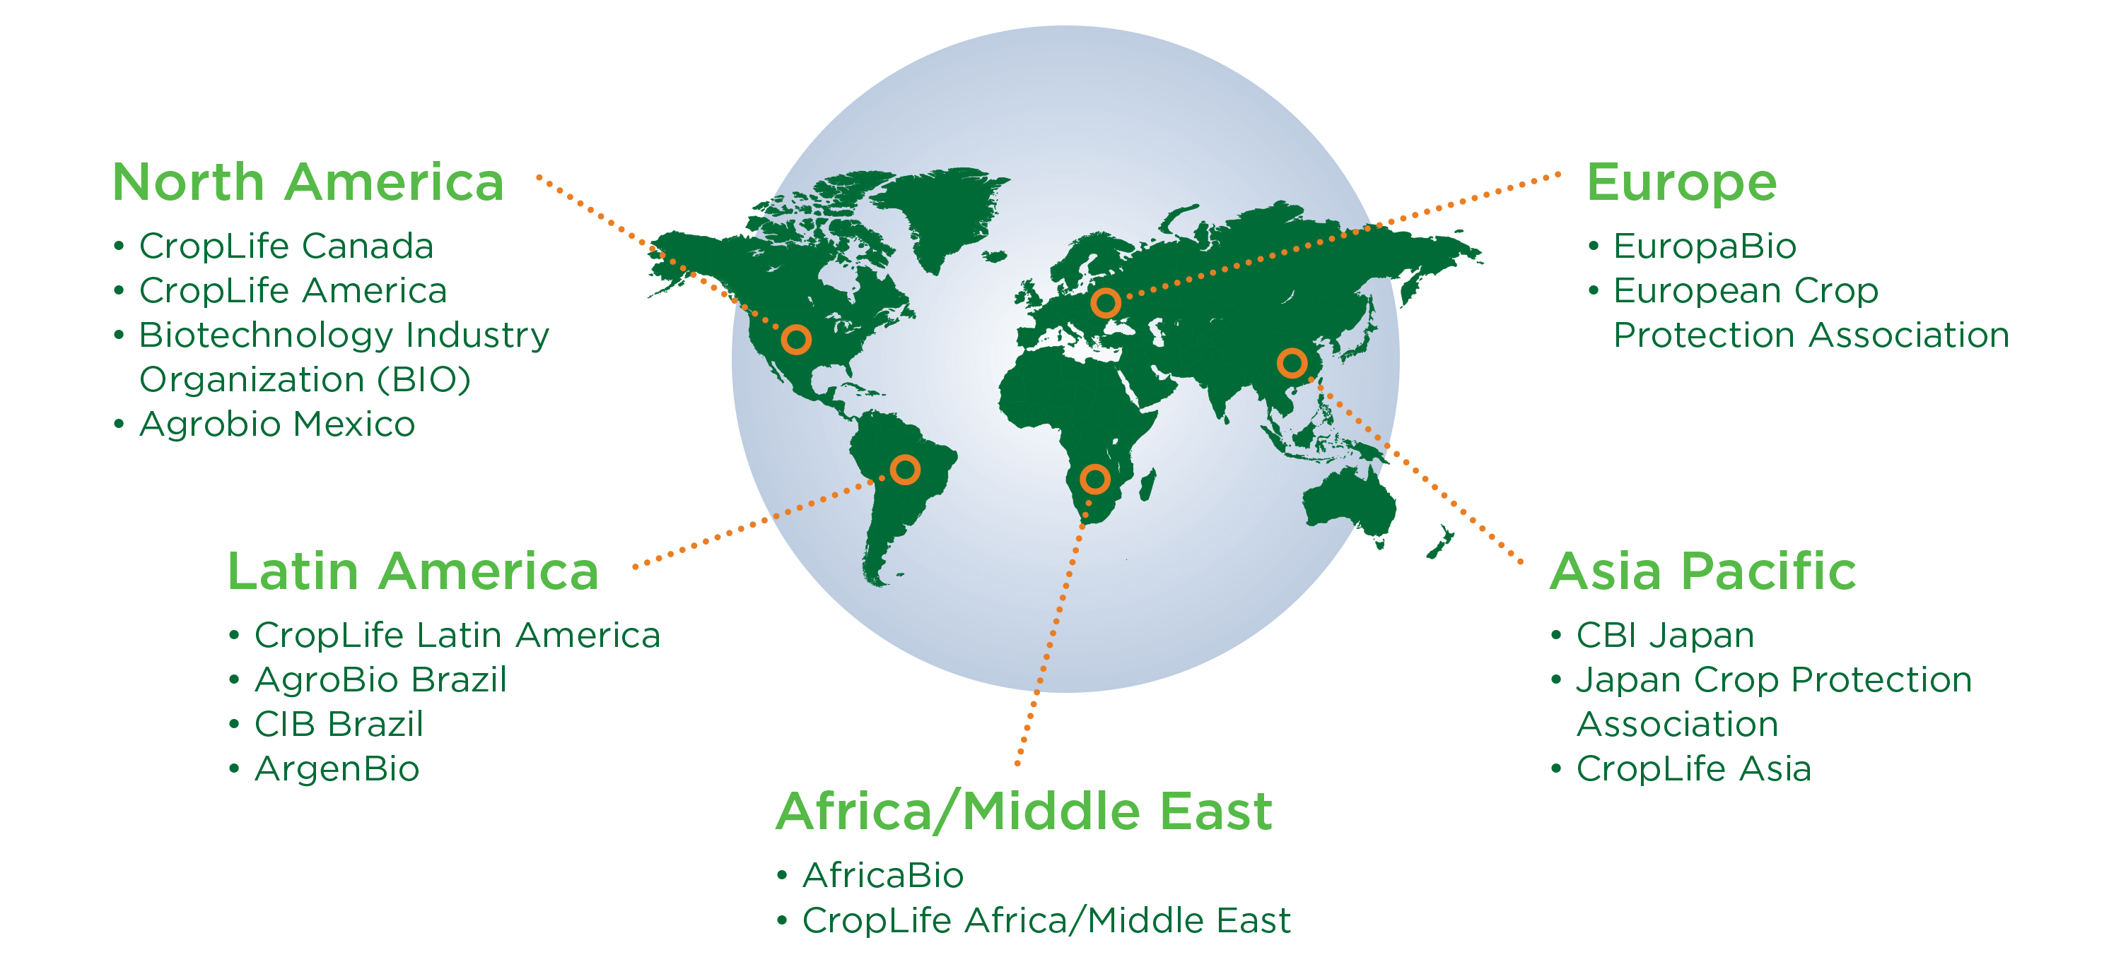
Members

Slide 4
PB Structure
Plant Biotech Strategy Council
North Asia Task Force
Regulatory Steering Committee
Global Alliance for AgBiotech Trade Steering Committee
Stewardship Steering Committee
Plant Breeding Innovation Task Force
Global Industry Coalition Steering Committee
Communications Steering Committee
Intellectual Property Steering Committee
Multilateral Affairs Steering Committee
Project Teams:
Food Feed,
New Breeding Techniques,
Stacks,
Environmental Risk Assessment
Project Teams:
Plant Related Inventions,
Access and Benefits Sharing
Project Teams:
Plant Related Inventions,
Access and Benefits Sharing
Project Team:
Global Alliance for AgBiotech Trade Coordinating
Grey boxes: Includes non-CLI members
Yellow boxes: Cross Platform CP & PB Committees
Green/Tan/Orange/Blue boxes: Only CLI Plant Biotech Members
Notes:
The following teams will serve on an ad hoc nature, as needed to serve the strategy of the Regulatory Steering Committee and the global CLI strategy.
So they won’t do anything unless activated by the Regulatory Steering Ctte to put another way. They are still free to make proposals to the RC however this must be in line with their strategy for them to pursue the task.
Groups include:
Non-Commercial Reference Variety – (Task Force, was likely to end after its task)
Statistical Analysis
OECD
Detection Methods
Toxicology
Molecular Characterization
Allergy
Dietary Exposure
Acceptance teams have been removed for simplicity of the chart. Stewardship is under review and likely will be a cross platform spot in future. To be determined.

Slide 5
Crop Protection Structure
Crop Protection Strategy Council
Highly Hazardous Pesticides Task Force
Stewardship Steering Committee
Operations Steering Committee
Regulatory Steering Committee
Endocrine Disrupter Task Force
Pollinator Task Force
Anti-Counterfeiting Steering Committee
Multilateral Affairs Steering Committee
Communications Steering Committee
Project Teams:
IPM/RU,
Container Manangement,
Obsolete Stocks
4 Resistance Action Committees
Project Teams:
EHS, Traceability,
Product Integrity
Project Teams:
PRD, PIC/POPs, Consumer Safety, Minor Use, ERA, OpEx, Biocontrol
Grey boxes: Includes non-CLI members
Yellow boxes: Cross Platform CP & PB Committees
Green/Tan/Orange/Blue boxes: Only CLI Plant Biotech Members
Notes:
The following teams will serve on an ad hoc nature, as needed to serve the strategy of the Regulatory Steering Committee and the global CLI strategy.
So they won’t do anything unless activated by the Regulatory Steering Ctte to put another way. They are still free to make proposals to the RC however this must be in line with their strategy for them to pursue the task.
Groups include:
Non-Commercial Reference Variety – (Task Force, was likely to end after its task)
Statistical Analysis
OECD
Detection Methods
Toxicology
Molecular Characterization
Allergy
Dietary Exposure
Acceptance teams have been removed for simplicity of the chart. Stewardship is under review and likely will be a cross platform spot in future. To be determined.

Slide 6
Representatives
 | Board of Directors | Crop Protection Strategy Council | Plant Biotech Strategy Council
BASF | M. Heldt | J. Huff | R. van Genderen
Bayer | L. Condon | B. Naaf | N. Stevens
Dow AS | T. Hassinger | R. De La Cruz | M. Krieger
DuPont | J. Collins | T. Glenn | J. Flint
Monsanto | B. Begemann | J. Ferreira | P. Miller
Syngenta | E. Frywald | J. Parr | S. Hull
Sumitomo |  | R. Nishimoto | -
FMC |  | M. Douglas | -
 |  | CropLife America: J. Vroom | Bio Food & Ag: Vacant
 |  | CropLife Africa ME: R. Guyer | AfricaBio: B. Maseko
 |  | CropLife Asia: S.H. Tan | CropLife Asia: S.H. Tan
 |  | CropLife Canada: T. Menzies | CropLife Canada: S. Yarrow
 |  | CropLife Latin America: J. Perdomo | ArgenBio: G. Levitus: CIB: A. Brondani: AgroBio Brazil: E. Kay; AgroBio Mexico: A. Monteagudo
 |  | ECPA: J.C. Bocquet | EuropaBio: B. Spaeth
 |  | JCPA: H. Takashi | CBI Japan: I. Yasufumi

Slide 7
Stewardship Review

Slide 8
Stewardship
Outcomes of Committee Review
Opportunities exist for cross platform collaboration
Establish one steering committee for both PB and CP technologies
PB has role in resistance management, IPM
Need to focus on priorities for industry
Establishment of a resistance management project team to lead a global approach and coordinate RACs
More effort required to build partnerships, secure additional funding and resources
Better integration of global priorities with regional programs

Slide 9
Stewardship Committee
Proposed structure supported by CPSC-PBSC
Stewardship Steering Committee
Resistance Management PT
Integrated Pest Management PT
Container Management PT
HRAC
IRAC
FRAC
RRAC
Obsolete Stocks PT
SSC, RM and IPM – cross platform CP-PB
Need to nominate members which will represent both technologies
RM project team will have oversight of RACs
ObStocks – act as an ad hoc team when required

Slide 10
Stewardship Review
Over next 2 months with each member company
Situational analysis – the next 3-5 years
Priorities for activity/areas of focus
Strategic goal and objectives
Geographical locations for priority
Committee and project team structure

Slide 11
CropLife International Stewardship Activities

Slide 12







Stewardship Arch: Crop Protection
Operations Committee
Stewardship Committee
Storage, Transportation & Distribution
Integrated Pest Management
Responsible Use
Manu- facturing
Container Management
Research & Development
Management & Disposal of Obsolete Stocks

Slide 13
Location of association supported IPM/RU programs
300+ partners
Average of 300,000 individuals directly trained each year

Slide 14
Location of industry-led container management programmes
40 established programs plus 24 pilots

Slide 15
Location of obsolete pesticide stocks collection

Slide 16
Stewardship
Crop Protection Budget
Objectives | 2016 | 2017
1. Global Stewardship Guidance | 110,000 | 50,000
2. IPM/Responsible Use | 200,000 | 200,000
3. Container Management | 60,000 | 60,000
4. Obsolete Stocks | 5,000 | 5,000
5. Resistance Management | 417,000 | 387,000
6. Regional Stewardship Support | 1,250,000 | 1,130,000
Total | $2,042,000 | $1,832,000

Slide 17
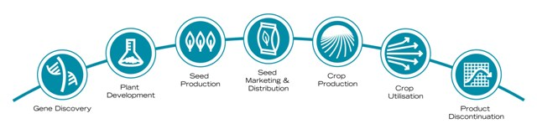
Stewardship Arch: Plant Biotech

Slide 18
CLI Network PB
Country | Activity | Spend
All Programs | Advocate good stewardship practices for industry brand management | -
Australia | Engage with cotton industry stakeholders relating to IRM stewardship of biotech traits in Australia | $15k
Vietnam | Policy advocacy on stewardship to government | <$79k
Pakistan | Refuge/IRM approaches – advocacy to policy makers | <$25k
South Africa | Capacity building activities for farmers to incorporate stewardship practices in demonstration trials | $36k
Argentina | Outreach & advocacy with farmers, policy makers, regulators, and academica to understand and support industry stewardship imitative (IRM, WRM, and ETS) | $60k
Brazil | Description on following slide | $675k
Mexico | Work with growers for cultivation permit requirements for gov’t inspections | <50k
 | Total | <$940k

Slide 19
Brazil
Improvement of the existing Insect Resistance Management (IRM) program aligned with stewardship strategies to ensure product durability and sustainability. $473k
Academia and industry are engaged and supporting the implementation of IRM program.
Growers associations and key opinion leaders at the farm level are engaged and supporting the implementation of IRM program.
Studies and articles on technology loss economic impacts conducted and disclosure to key opinion leaders and media at the farm level.
The regional refuge reward program communications plan implemented and operating.
Key media endorsing proactive IRM stewardship communications messages.
Development and implementation of a Weed Resistance Management (WRM) program aligned with stewardship strategies to ensure product durability and sustainability. $202K
Value chain stakeholders (growers associations, academy, industry) to be engaged and assisting implementation of WRM stewardship program.
Implement the WRM communications plan at the farm level.

Slide 20
Stewardship
Plant Biotech Budget
Objectives | 2016 | 2017
1. ETS Membership | 45,000 | 45,000
2. Conferences/events | 10,000
3. IRM Pilot Program | 30,000
4. Local outreach/resources | 64,000
Total | $149,000 | $45,000

Slide 21
Situational Analysis

Slide 22
Factors impacting CP industry – from 8 members
Next 3-5 years, order of priority
1. Regulatory
2. Communications, advocacy, acceptance
3. Stewardship
4. Global trade

Slide 23
Stewardship
Details from CP survey
Growing need for more stewardship to minimize risk, prevent stricter regulation or product bans
Resistance (insecticide, herbicide, fungicide)
Endangered species, pollinators
Water contamination

Slide 24
Stewardship Review
Situational Analysis – 3-5 years
Increasing stakeholder scrutiny (NGO, IGO, consumers)
Sustainable resource use, carbon footprint and ecosystem services (water, biodiversity)
Advancement of biotechnology
Impacts of pesticides - pollinator health, highly hazardous pesticides, endocrine disruptors
Operator safety and exposure
Secondary standards
Counterfeit products and illegal trade
Growth of biological products
Resistance management growing importance
Association role vs company role in stewardship activities

Slide 25
Review of Stewardship Strategy

Slide 26
Outcome: Ensure long-term freedom to operate whereby crop protection products are accepted as an integral part of agriculture
Build societal trust
Increase resiliency of decision-makers
Support science-based regulation
Collaborate with stakeholders and value chain
Understand concerns through intelligence gathering
Conduct research to validate approach
Be visible and participate in a transparent public dialogue
Amplify Corporate Social Responsibility efforts
Multiply positive voices and create advocates
Utilize and apply a digital strategy to reach audiences
Map critics and proactively gather intelligence
Challenge and expose biased NGO motivations
Develop strategies for addressing emerging concerns
Forge non-traditional alliances with NGOs
Rapidly respond and identify impediments to moving faster
Manage legal challenges
Promote timely science-based regulatory decision making
Encourage 3rd party support and coalitions
Conduct research and reports to demonstrate thought leadership
Proactive dialogue with regulators to understand needs
Build capacity for risk assessment
Strengthen support from scientific communities
Conduct stakeholder mapping
Forge alliances with food companies and retailers
Mitigate impact of secondary standards
Create like-minded coalitions within the food chain and NGOs
Connect and partner with health and environment groups and public organizations
Issue management: proactive/reactive strategies
Capabilities: intelligence gathering; advocacy competency; timely decision making; efficient resource structure; best practice guidelines; digital and social media use; funding

Slide 27
Stewardship Review
Current goals of the programs
CP Goal:
To be recognised as a responsible industry promoting effective stewardship programs, which are essential elements of sustainable agriculture, food security and food safety.
PB Goal:
Achieve industry alignment in the development and implementation of best stewardship practices within the context of IPM, which can be localized and promoted by national associations.

Slide 28
Strategic Objectives
1. Implement stewardship programs.
Promote and implement stewardship so that it is recognised by internal and external stakeholders as a vital contributor to sustainable agriculture.
2. Advocate for industry approach.
Position the crop protection industry so that it is recognised as the key source of expertise in stewardship and other stakeholders adopt our approach.
3. Alignment of global strategy.
Promote alignment of industry stewardship strategy, areas, and priorities at global, regional and national levels
4. Support regional/national programs.
Support regional stewardship projects that have been adapted to regional and cultural differences, and demonstrated needs
5. Report program impact and results.
Promote and report industry-wide stewardship performance indicators and measure progress against these.
6. Develop partnerships.
Promote stewardship throughout the value chain through partnerships and demonstration of stewardship best practices.

Slide 29
Focus Areas
Integrated Pest Management and Responsible Use | IPM/RU programs implemented at field level in partnership with stakeholders demonstrating effective training methodologies and approaches that address the appropriate handling and use of crop protection products and technologies (chemical pesticides, biologicals and biotechnology-based).
Container Management | To develop safe, responsible and sustainable container management programs worldwide, with our industry recognized as a leader for this initiative promoting efficiencies and cost reduction.
Obsolete Stocks | Through partnerships promote the removal of legacy obsolete stocks, with a focus on stocks originating from CropLife International member companies, and promote the implementation of effective measures to prevent future build-up.
Resistance Management | Promote voluntary resistance management programs to all relevant industry and non-industry stakeholders. This includes programs for conventional and biotech crops.

