Slide 1
Synthetic Auxin Herbicide Working Group Update
November 17, 2016
Bob Masters

Slide 2
Role of Working Groups
Global HRAC is viewed as an important source of technical information on herbicide resistance
Working Groups are key to fulfilling this mission
Key objectives for Working Groups:
Consolidate and communicate information for specific MOAs
Monitor research
Support intellectual dialogue
Customize BMPs for a given MOA
Address specific resistance topics (e.g. Monitoring)

Slide 3
Current Working Groups
MOA-based:
HPPD Working Group
Auxin Working Group
Others
Monitoring and Mitigation
Website and Communication

Slide 4
Current Working Group Issues
Limited number of Working Groups
Limited membership (invite non-Industry members?)
Time commitment
Funding
Working Group structure and function should be a key topic for HRAC strategy development

Slide 5
Synthetic Auxin Herbicide Working Group Members
BASF
Andreas Landes
Bayer
Arlene Cotie
John McGregor
Dow AgroSciences
Bob Masters
David Simpson
Terry Wright
Bo Braxton
DuPont
Maria Salas
Monsanto
Michael Horak
Ryan Rector
Alejandro Perez-Jones
Syngenta
Don Porter

Slide 6
Future AWG Goals and Objectives
Determine what the group wants to address next
Looking for projects that fit group resources (people, time and funds)
Goal | Objectives | Timeline
Robust definition of current state of auxin resistant weed populations | Review of auxin resistance cases in International Survey Analysis of reported cases based on published literature and investigation Preparation of a report on current status of auxin resistance | Q2 2014 Q3 2014 Q3 2014
Identification of resistance mechanisms and their inheritance in AR biotypes | Review of published mechanisms Identify current auxin resistance investigations and reach out to researchers Feasibility study of fitness research project | Q2 2015 Q2 2015 Q3 2015
Ensure that accurate information on auxin resistant weeds is available to the weed science community and the public | Determine how suspected auxin resistant biotypes should be evaluated What level of background variability is typical for auxin herbicides Provide reviews of auxin resistant weeds Sponsor a symposium or meeting of key researchers on auxin resistant weeds (move to 2017) | Q2/Q3 2015 Q2/Q3 2015 Q3/Q4 2015 Q1 2017
Provide best available recommendations for management of auxin-resistant biotypes | Determine if auxin herbicides merit BMPs that are different from other MOAs Other | TBD

Slide 7
Auxin-Resistant Weed Factsheets
http://hracglobal.com/tools/fact-sheets
Kochia
Wild radish
Corn poppy
Wild mustard
Lambsquarters
Waterhemp
Next steps
Develop process to maintain currency of fact sheets?
Identify new fact sheets
Phenoxy-resistant corn poppy
Others

Slide 8
Symposium Sponsored by Global HRAC
The symposium, “Weed Resistance to Synthetic Auxin Herbicides: Current State of Knowledge and Knowledge Gaps,” will occur on May 15, 2017 from 1300 to 1700 hours.
The symposium will be comprised of a series of presentations that provide:
Overview of the current knowledge of synthetic auxin herbicide resistance;
Description of case studies of weed species with confirmed resistance to synthetic auxin herbicides; and
Perspectives about how to manage resistance in synthetic auxin herbicide-tolerant crops.
There will be a facilitated panel and audience discussion about building our knowledge about synthetic auxin herbicide resistance so the long-term viability and utility of synthetic auxin herbicides can be sustained.
All invited speakers were contacted September 18, 2016 and they have enthusiastically accepted.
Global HRAC has provided funds ($10,000) to help non-industry speakers with travel expenses.

Slide 9
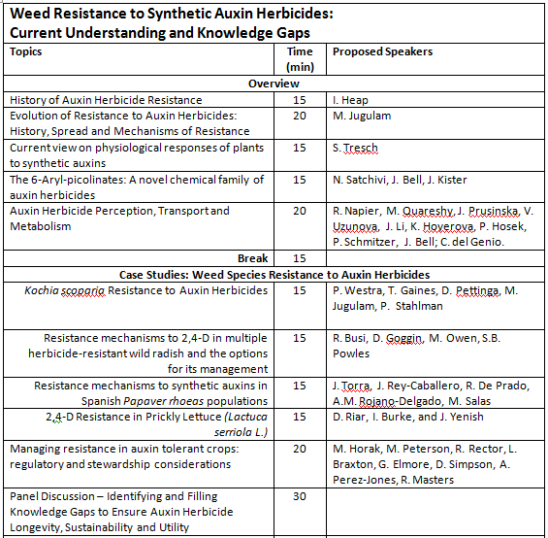
Global Herbicide Resistance Challenge 2017 Symposium

Slide 10
Symposium Synopsis Requested by GHRC 2017 (November 15, 2016)
The era of modern herbicides began in the early 1940s with the introduction of the synthetic auxins, 2,4-D and MCPA.
Now there are products from six different chemical classes of synthetic auxin herbicides in the market.
There are only 32 auxinic herbicide-resistant weed species that have been discovered worldwide despite widespread use for over 60 years.
With the recent development of auxin-tolerant crops, there is widespread interest about how best to protect this technology from the threat of herbicide-resistance and to ensure its long-term viability and utility.
During the GHRC 2017 conference there will be a symposium, “Weed Resistance to Synthetic Auxin Herbicides: Current Understanding and Knowledge Gaps.”
This symposium will provide a forum to discuss the current knowledge about synthetic auxin herbicide resistance, describe the nature of resistance to synthetic auxin herbicides, and perspectives about how to sustainably manage resistance with the advent of synthetic auxin herbicide-tolerant crops.

Slide 11
Auxin Working Group Opportunities
Global HRAC Website
Develop process with AWG to keep the fact sheets updated and timely
Suggested new weeds for which to develop fact sheets
Considering reports on weed species for which there may be conflicting reports of resistance that may actually be tolerance
Marestail (ERISS)
Palmer amaranth (AMAPA)
Look for other auxin-resistant weeds outside EU and US to further globalize AWG efforts and outreach
Create means by which AWG members can share new publications and other information in a timely manner to all members.
Arlene suggested considering Google Docs (https://www.google.com/docs/about/) for sharing draft documents during review process and also archive other documents of interest to group.
Perhaps use secure “members only” location on new Global HRAC site.

Slide 12
Auxin Working Group Opportunities
Resistance Best Management Practices
How can we develop the best means of communicating BMPs to reach growers and Impact their decisions?
AWG members interface directly with grower groups globally
Support second phase of Global HRAC communication strategy building off soon to be created Global HRAC Strategic Plan.
Contributing to building stronger relationships and collaboration with regional HRACs
Expanding Working Groups to Include non-CLI and non-industry members where feasible and appropriate for Working Groups to achieve objectives
Need to understand what constraints to enlisting members outside industry or CLI.
Global HRAC Constitution allows great flexibility to Working Group membership
Important to consider inviting experts with member companies that have specific expertise that can contribute to activities, i.e, chemists, discovery biologists, marketing, communication specialist, etc.

Slide 13
Topic for consideration by Global HRAC
What impact will industry consolidation have on building and maintaining active engagement of industry representatives with working group activities?

Slide 14
Topics for Next AWG Meeting November 30, 2016
Update on GHRC 2017 Symposium
Brainstorm about symposium panel session
Funding for invited speakers
Status of weed resistance fact sheets
Global HRAC Strategy implications for AWG
Possible AWG Activities
Contributions to Global HRAC website – review currency of content
Networking with other industry groups, i.e., regional HRACs
Collaborations outside HRAC and Industry
Publication opportunities, target audience, and outlets
Poster development for professional society meetings/Website

Slide 15
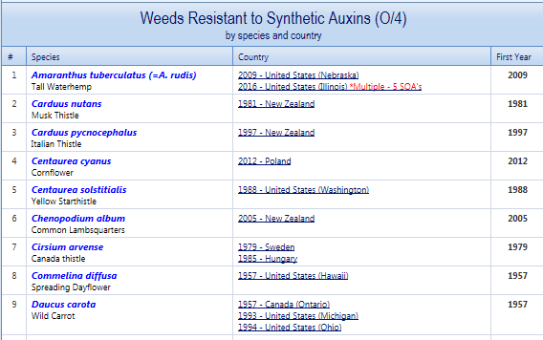
November 17, 2016 weedscience.org

Slide 16

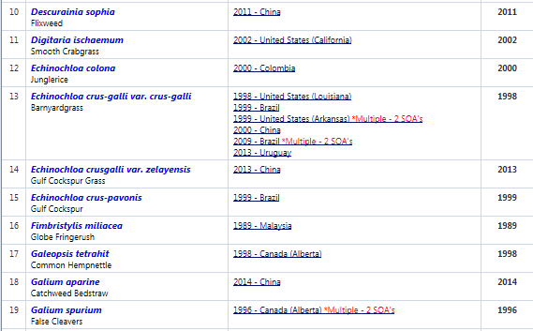
November 17, 2016 weedscience.org

Slide 17
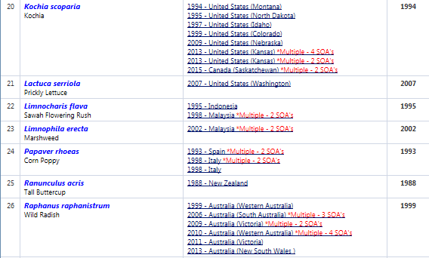
November 17, 2016 weedscience.org

Slide 18
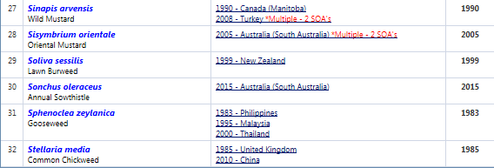
November 17, 2016 weedscience.org

