Slide 1
Global HRAC Meeting – Denver May 2017
CropLife Australia
Herbicide Resistance Management Review Group (HRMRG)
Jason Sabeeney
Chair – CropLife Herbicide Resistance Management Review Group
Notes:
For those that don’t know me and have only heard Department of Ag people speak about me you are probably a little confused a this stage, don’t panic I just decide to leave my second head and devil horns at home today.
I've been fortunate enough to be in this role for 6 years now and think it is an amazing sector however I can assure you that every other person in the room knows more about the agricultural chemistry and regulatory science than I do. My background has been in politics, defence industry and national security policy (I wasn’t smart enough to do science at University so I did law instead). Its why I have such amazing, intelligent and experienced adult supervision in the CropLife office, two are here today, our Director of Agricultural Chemical Policy, Alastair James, and our Director of Crop Biotechnology Osman Mewett.
So a little about CropLife to start.

Slide 2
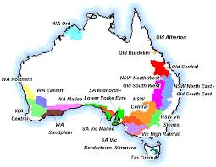
Australian Situation
Australian total crop area 23M ha
Wheat 13.0Mha
Barley 4.0Mha
Canola 2.5Mha
Oats 0.9Mha
Chickpeas 0.8Mha
Sorghum 0.6Mha
Lupins 0.5Mha

Slide 3
2016 GRDC Weeds Survey
Surveyed 600 Australian grain growers
Cost of weeds AU$3.3B
Cost of weed control AU$113/ha (all methods)
Cost of IWM practices 18% of the total
92% of growers use min/no tillage prior to sowing
61% of growers use double knock technique
46% of growers narrow windrow burn
64% of growers expect a new herbicide to be available in next 10yrs to control weeds resistant to current herbicides.

Slide 4
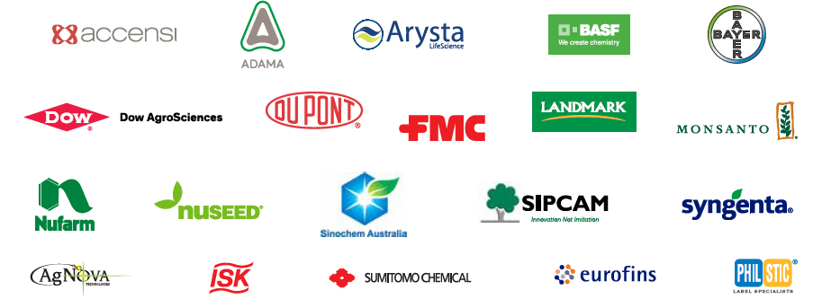
CropLife Australia
1 organisation representing 20 member companies committed to Australia’s farmers
Notes:
60 years of CropLife Australia
Long history of commitment to Australia’s farmers
Our members
But its not just a national perspective that we bring to our engagement

Slide 5









CropLife Australia
11 HRMRG Members

Slide 6

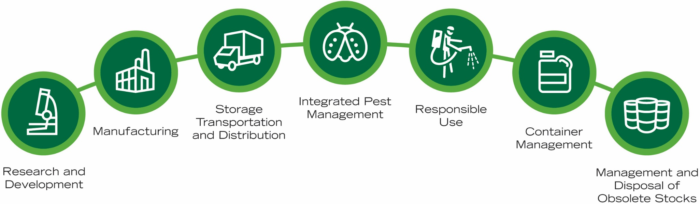
CropLife takes a whole-of-life cycle approach to stewardship

Slide 7
Australian HRMRG – Key Milestones
Herbicide resistance first reported in SA & WA in (1982) (Lolium rigidum)
Australian HRAC established in (1986). Group meets face to face annually and deals with other issues via email throughout the year.
Australia - First country in the world (1992) to introduce mandatory herbicide MOA classification on every herbicide label.
Australia first country in the world to report glyphosate resistance in Vic & NSW (1996) (Lolium rigidum)
Australian herbicide MOA classification system was revised in (1997) (first revision since introduction in 1992) to more accurately reflect all MOA groups and where possible align with HRAC groupings.

Slide 8
Australian HRMRG - Charter
The Herbicide Resistance Management Review Group (HRMRG) is a technical working group of CropLife Australia, consisting of member company representatives, established to provide advice to the agriculture industry on herbicide resistance issues.
The HRMRG is to update annual herbicide resistance management strategies, herbicide mode of action list and list of herbicide resistant weeds for use by industry, educators and farmers.
Key objectives of the group are to:
Monitor and review the status of herbicide resistance in Australia, consulting with relevant external expert bodies, including private researchers, advisers and grower industry representatives, as required.
Liaise with the international Herbicide Resistance Action Committee (HRAC), the Australian Pesticides and Veterinary Medicines Authority (APVMA), Australian Glyphosate Sustainability Working Group and other key bodies on herbicide resistance issues.
Review and classify new herbicides according to their mode of action.
Align MOA classification with HRAC groupings.
Identify and agree on resistance risk associated with specific weeds, herbicide modes of action, application methods and use patterns.
Proactively propose, review and agree on herbicide resistance management strategies to preserve strategic herbicide active ingredients or chemical groups where resistance has been identified or is considered a risk.
Update resistance management strategies for specific crop and weed situations as herbicides with alternate modes of action are registered for use, or proposed for registration.
Propose herbicide Mode of Action labelling to the APVMA.

Slide 9
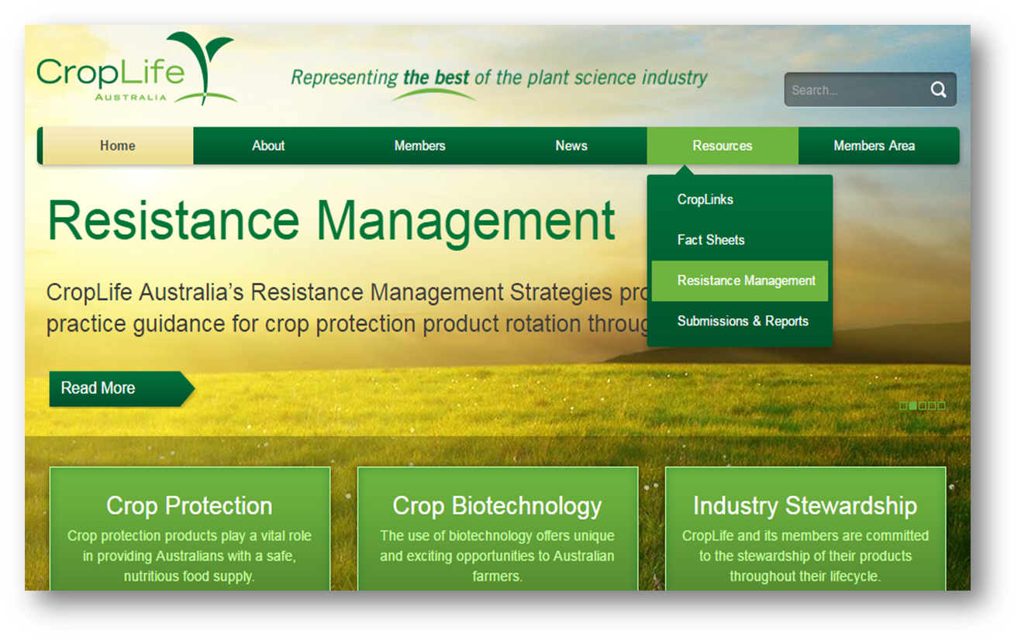
Resistance Management Strategies

Slide 10
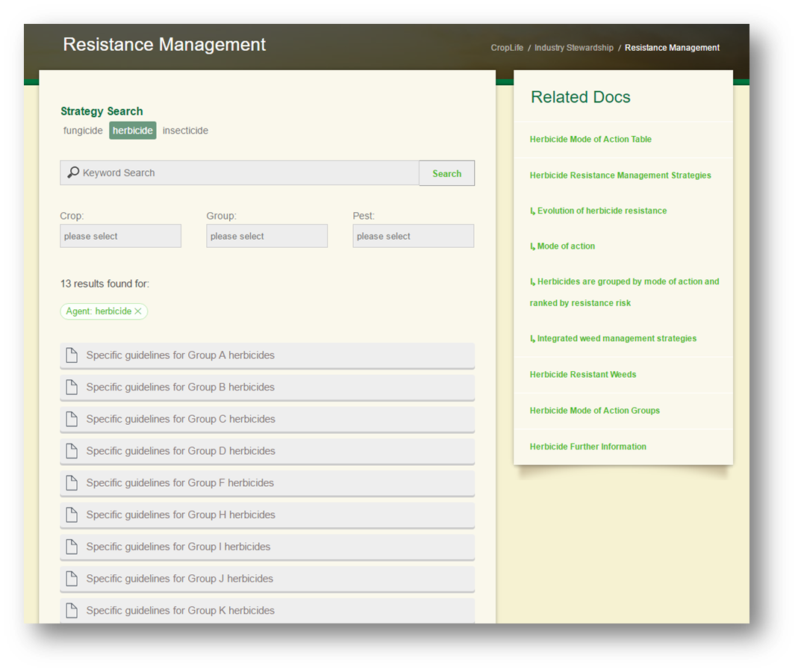
Resistance Management Strategies

Slide 11
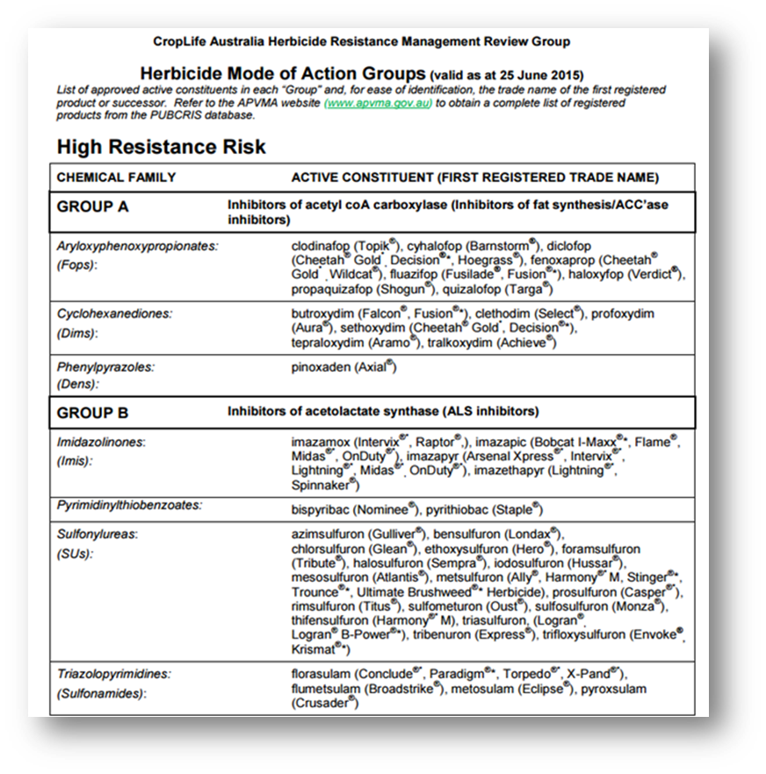
Australian Herbicide MOA Table

Slide 12
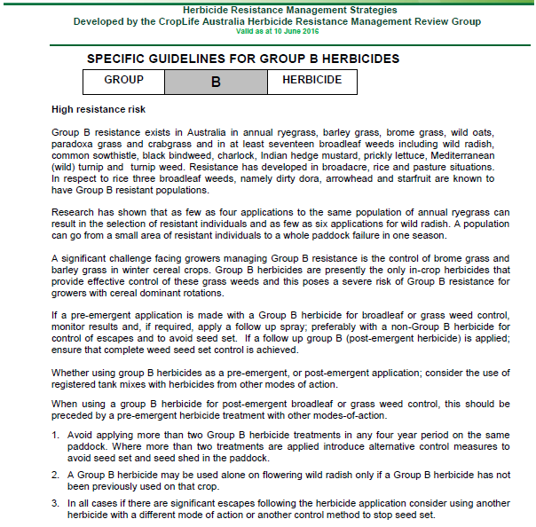
Australian Resistance Management Strategies

Slide 13
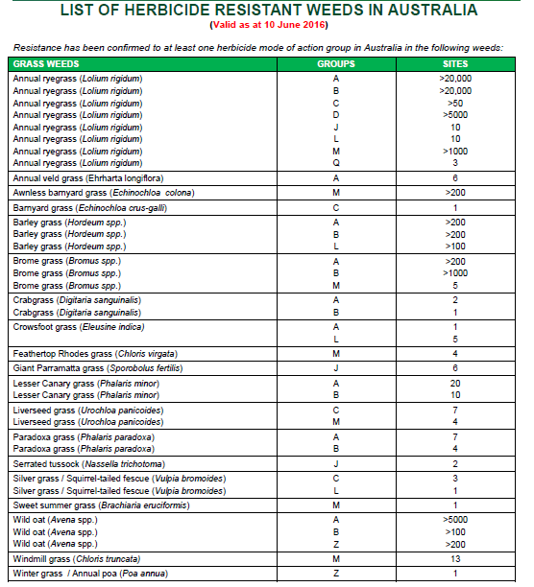

Slide 14
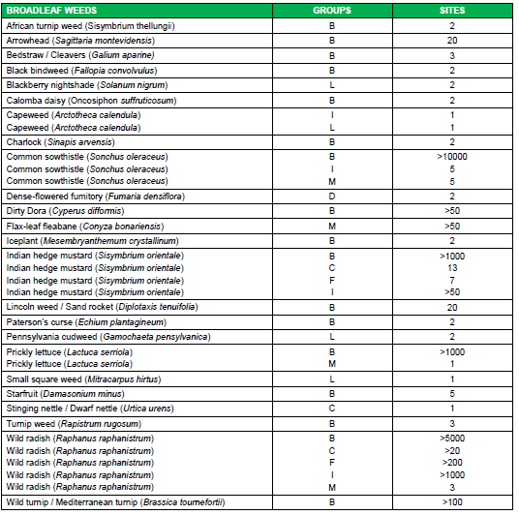
List of herbicide resistant weeds - Dicots

Slide 15
What is HRMRG currently working on?
Regarding current herbicide resistance strategies:
Developing a high risk weeds section (Top 12 most problematic) Inc. links to management advice by weed & risk matrix
Developing a table summarizing MOA x number of resistant species x country Vs Australia to create global perspective on risk
Looking to incorporate some material from HRAC website into our local strategies to provide some more
Discussed how to promote material on the CropLife website more effectively in AU
Looking to collaborate more with other countries and global HRAC e.g. NZ

Slide 16
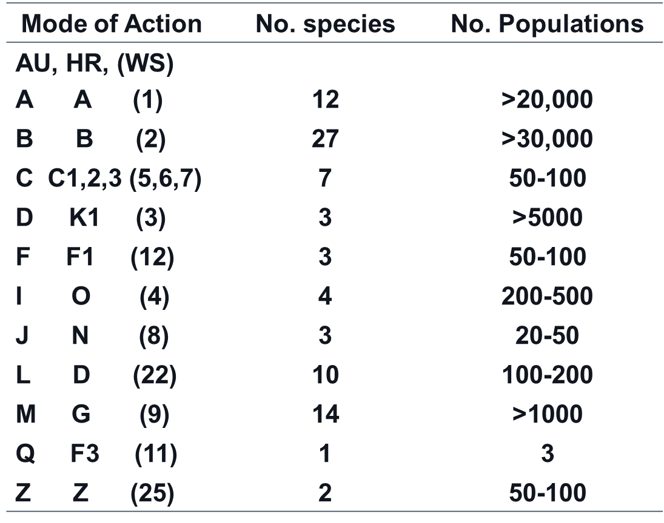
Current state of herbicide resistance in Australia - May 2017
Source
Dr Chris Preston
Uni. Adelaide

Slide 17
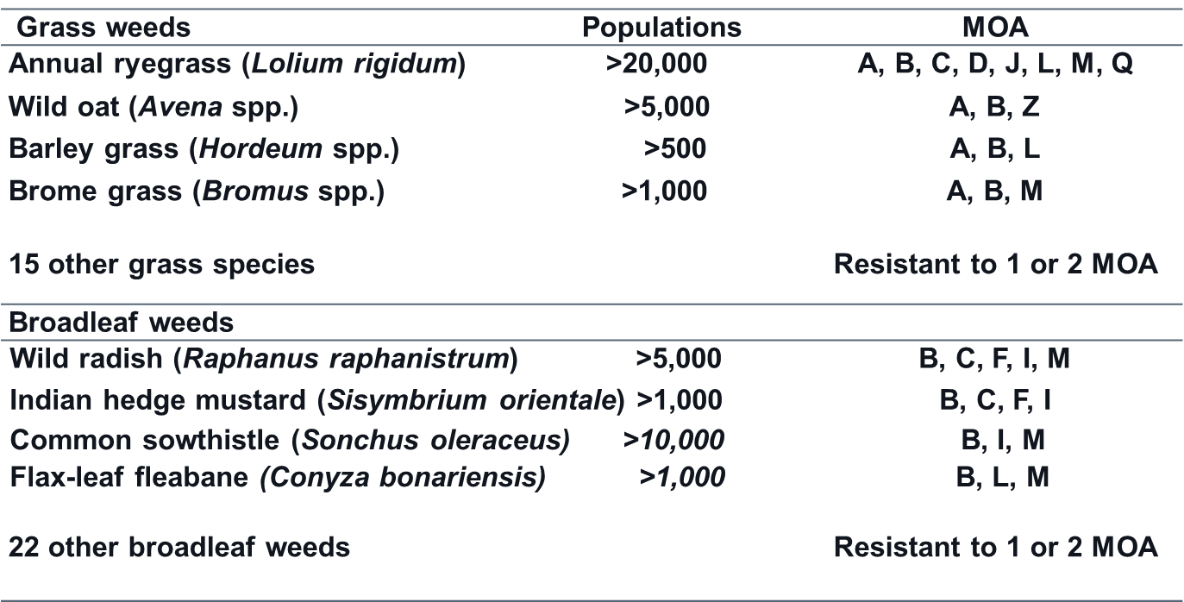
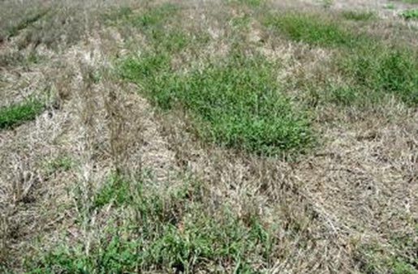
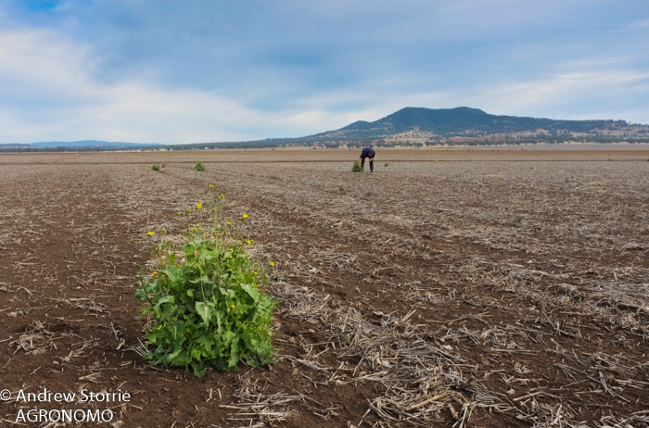
Most problematic herbicide resistant weed species in Australia - May 2017
Source
Dr Chris Preston
Uni. Adelaide

Slide 18
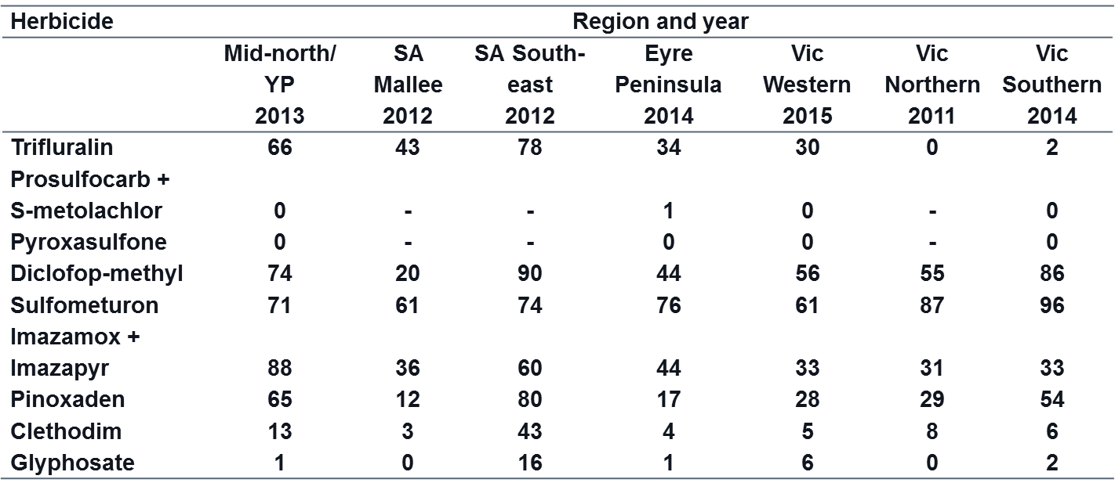
Extent of resistance to herbicides in annual ryegrass in SA and VIC
Source
Dr Chris Preston
Uni. Adelaide

Slide 19
What does the Australian HRMRG want from Global HRAC?
Interaction and sharing of information
  Could we collaborate more regularly and share challenges, ideas, strategies, information, wins and best practice?
  Could we have an annual or biannual face to face meeting or video link?
Alignment of strategies and messaging
  Could we work towards a global MOA classification system?
  Include Australian MOA categories on HRAC website?
  Could we develop overarching MOA strategies globally and tailor them to local situations for consistency?
Promotion of strategies and messaging
  Could we do more to promote the work of the HRAC globally and regionally ?

Slide 20













Australian HRMRG – Key Collaborators

Slide 21


CropLife Australia
Contact CropLife Australia
https://www.croplife.org.au
CropLife Australia-HRMRG content
https://www.croplife.org.au/industry-stewardship/resistance-management/

